Slide 1
Irrational Exuberance:
“2014-2015 China stock market bubble”
Renhao Qian; Yifei Wu; Yuxuan(Isabel) Luo

Slide 2
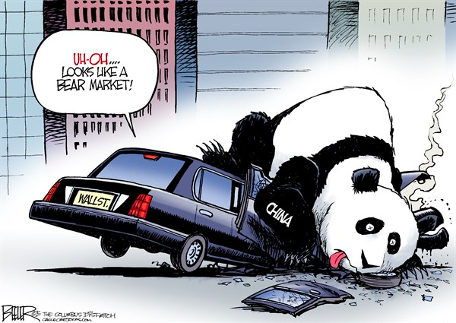
Agenda
Introduction
Background information: The “bubble”
Theories & Analysis: Explaining the “bubble”
Macroeconomics: The role of government
Financial economics: The role of financial institutions
Behavioral economics: The role of investors
Reflections & Conclusions

Slide 3
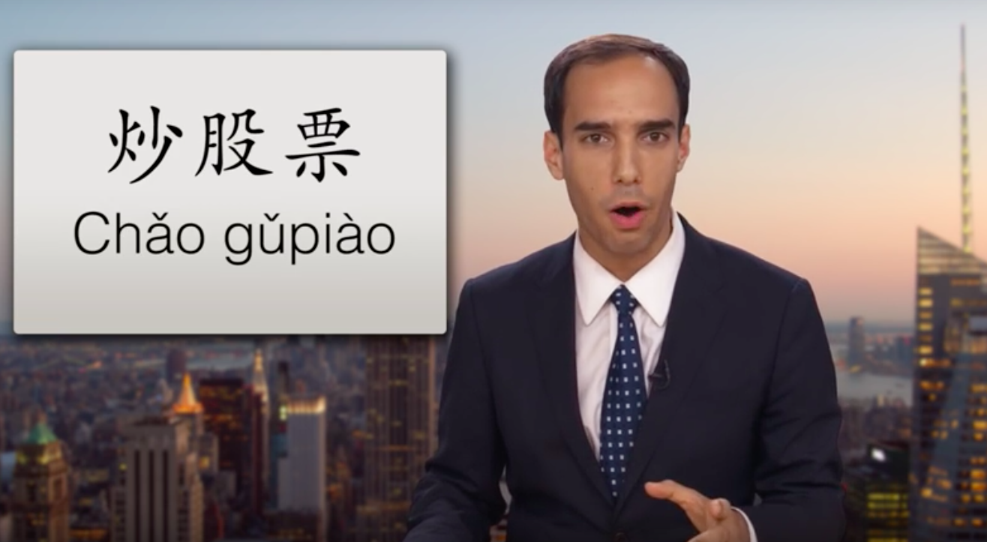
China stock market bubble 2014 - 2015: - An Overview
Introduction
Background information
Theories & Analysis
Reflections & Conclusions
Notes:
https://www.youtube.com/watch?v=TPMmoJrkxeg

Slide 4
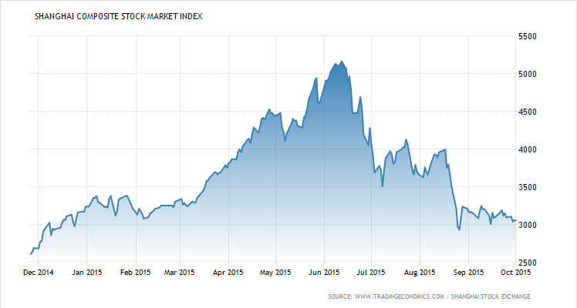
Shanghai Composite Stock Market Index (2014.11.26 – 2015.9.30)
T3: 2015.06.12
Introduction
De-leverage
Market rescue
T4: 2015.07.08
Background information
Central bank cut rates again
T2: 2015.03.01
T5: 2015.08.31
Theories & Analysis
Central bank cut rates
Futures market shut down
T1: 2014.11.26
Reflections & Conclusions
Source: tradingeconomics.com
Notes:
去futures contract, avoiding short sell.

Slide 5
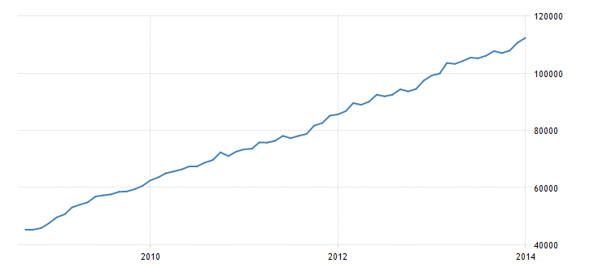
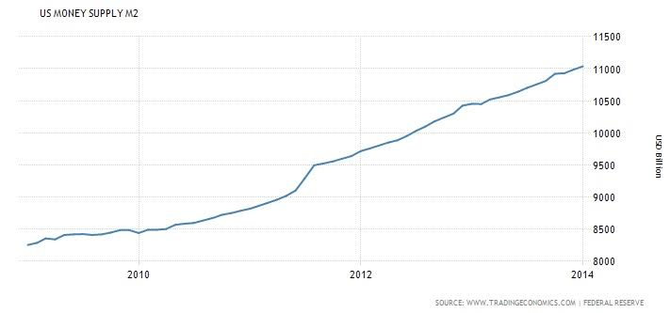
Before the bubble:
Introduction
From 2009 to 2014, M2 increased from 40 trillion to 120 trillion yuan in China.
In the U.S., M2 increased from 8 trillion to 11 trillion dollars, less than the increase in China.
Background information
Theories & Analysis
Reflections & Conclusions
China Money Supply M2 (2009.01.01 – 2014.2.01) in RMB
US Money Supply M2 (2009.01.01 – 2014.2.01) in dollar.

Slide 6
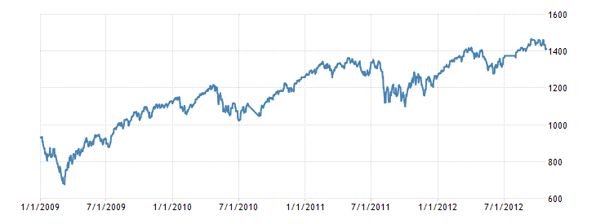
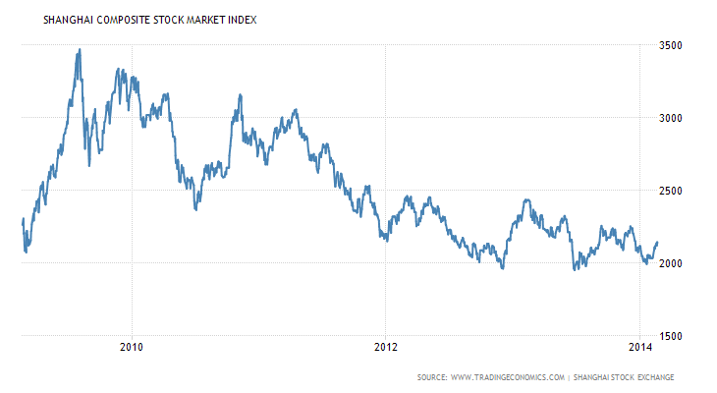
Before the bubble:
Introduction
However, the increased liquidity had not been benefiting Chinese stock market compared to the U.S. stock market.
Background information
Theories & Analysis
Reflections & Conclusions
S&P 500 Stock Market Index (2009.01.01 – 2014.2.01)
Shanghai Composite Stock Market Index (2009.01.01 – 2014.2.01)

Slide 7
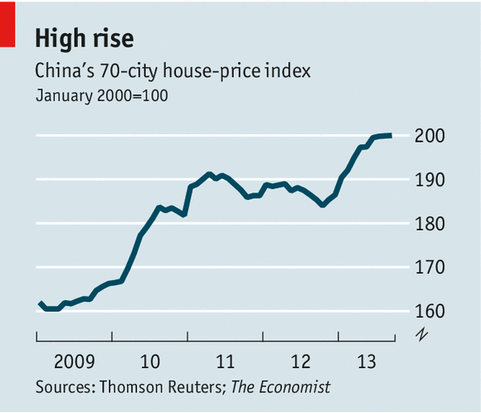
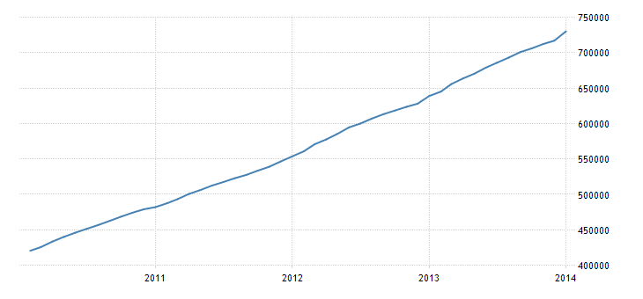
Before the bubble: Where did the money go?
Introduction
Overheated real estate market.
Size of expensive bank loans to private sector keeps expanding.
Unhealthy for the growth of the real economy.
Background information
Theories & Analysis
Reflections & Conclusions
Bank loans 2010 – 2014
unit: CNY

Slide 8
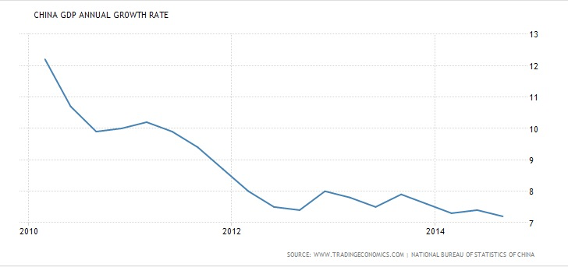
Before the bubble: in the meantime…
Introduction
China experienced diminishing real GDP growth from 2010-2014.
Background information
Theories & Analysis
Reflections & Conclusions

Slide 9
T1-T2 “Rational Exuberance”:
T3: 2015.06.12
Introduction
De-leverage
Market rescue
T4: 2015.07.08
Background information
Central bank cut rates again
T2: 2015.03.01
T5: 2015.08.31
Theories & Analysis
Central bank cut rates
Futures market shut down
T1: 2014.11.26
Reflections & Conclusions
Source: tradingeconomics.com
Notes:
第一次降息
第二次降息
去杠杆
救市 补充流动性
去futures contract, avoiding short sell.

Slide 10
T1-T2 “Rational Exuberance”: Macroeconomics perspective
Introduction
Background information
Facing the economic situation, the government took actions :
Used monetary tools to stimulate economic growth and reduce financing costs for private sector.
Central Bank cut rates and reserve ratios.
Encouraged firms to use equity financing to replace debt financing.
Implemented more rigid regulations on real estate investment.
As a result:
Liquidity went to stock market rather than real estate market.
Stock market started to rise.
Theories & Analysis
Reflections & Conclusions

Slide 11
T1-T2 “Rational Exuberance”: Individual decision-making point of view
Introduction
Suppose people choose between two types of assets:
Risk-free assets (e.g. bank deposit).
Risky assets (e.g. stock market).
Risk-free assets became less attractive due to the lower interest rate. (Less expected return)
Those people who were previously indifferent between the two assets would be willing to buy more stocks.
➡️ Reallocation of household assets.
➡️ More demand for stocks, pushed the price up.
Background information
Theories & Analysis
Reflections & Conclusions

Slide 12
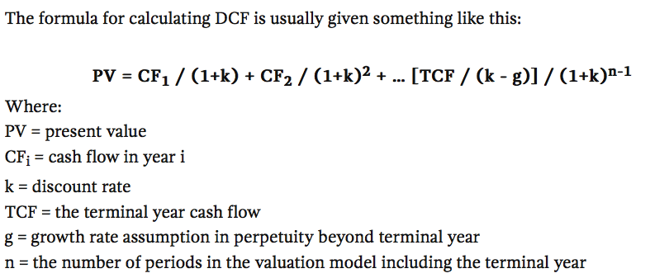
T1-T2 “Rational Exuberance”: Financial Economics perspective
Introduction
Common stock valuation theory
Background information
Theories & Analysis
Reflections & Conclusions
All else equal, a lower market interest rate lead to a lower discount rate (k), therefore generating a higher valuation of stock.
Now, value of stock>price of stock stock market underpriced opportunity to make profits new money into stock market drive price up.

Slide 13
T2-T3: Bubble formation
T3: 2015.06.12
Introduction
De-leverage
Market rescue
T4: 2015.07.08
Background information
Central bank cut rates again
T2: 2015.03.01
T5: 2015.08.31
Theories & Analysis
Central bank cut rates
Futures market shut down
T1: 2014.11.26
Reflections & Conclusions
Source: tradingeconomics.com

Slide 14
T2-T3 Formation of the bubble: Macroeconomics perspective
Introduction
Background information
Government further reduced interest rate and reserve ratio to stimulate economy and reduce financing costs for private sector.
Meanwhile, the government widened the window for IPOs to promote equity financing.
IPOs are favored by investors because of their relatively low valuation and correspondingly potential high returns - attract more hot money into market.
As a result, increasing demand in the market drove price up even further.
Theories & Analysis
Reflections & Conclusions

Slide 15
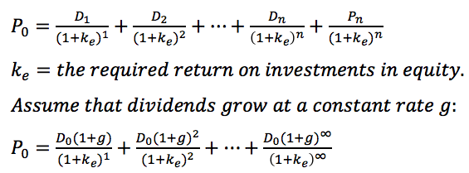
T2-T3: Financial Economics perspective - Gordon Growth Model
Introduction
Background information
During T2-T3:
- g is expected to increase.
- P₀ goes up.
Theories & Analysis
Reflections & Conclusions

Slide 16
T2-T3: Financial Economics perspective - Minsky’s financial Instability Hypothesis
Introduction
When the economy is growing, asset markets should grow correspondingly.
➡️ As an asset market offers higher returns than the cost of borrowing, some people use leverage to buy that type of asset.
➡️ Leverage raises demand in the market, causing the price to rise more quickly (a asset bubble begins to form).
➡️ The rocketing price encourages people to use higher leverage to magnify their returns, further pushing the price to go up (the bubble becomes larger)
(will be continued)
Background information
Theories & Analysis
Reflections & Conclusions

Slide 17
T2-T3: Financial Economics perspective - an overview of China’s financial system – Who is to blame?
Introduction
Households
Firms
Government
Savers
Information intermediaries
Borrowers
Financial intermediaries
Background information
Debt:
Commercial banks (long-term loans)
Mutual & hedge funds (bonds)
P2P institutions (short-term loans)
…
Audit firms
Securities companies
Media
…
Theories & Analysis
Reflections & Conclusions
Equity:
PE (primary and secondary)
VC (primary)
Mutual & hedge funds (secondary)
Securities companies (secondary)
…
Households
Firms
Government

Slide 18
T2-T3: Financial Economics perspective - Securities company vs. P2P institutions
Securities companies:
Stock brokers.
The most commonly used type of leverage for a retail investor is borrowing from stock brokers.
This type of leverage can be supervised and controlled, meaning that the central bank is able to know the amount of outstanding debt financed by securities companies and limit the amount by setting certain policies.
P2P institutions:
P2P, Peer-to-peer lending, enables individuals to borrow/lend money without an official institution like commercial banks.
P2P institutions connect borrowers and lenders, and they became very popular in recent years in China but not so popular in the US.
Provide much higher leverage for retail investors than securities companies.
How a P2P institution deals with borrowers:
Based on the level of leverage, a borrower have to transfer an required amount of equity into an account of the P2P institution first and then the P2P institution will add the predetermined amount of debt into the account.
The borrower could buy/sell on his own unless the equity falls below a certain level: the P2P institution will mandatorily sell the stock to repay the debt. Thereupon, the amount of outstanding debt financed by P2P institution is unknown to the central bank and extremely hard to regulate.
Notes:
However, there is another type of leverage increasing being used by retail investors during the formation of the bubble, which are mostly provided by P2P institutions.

Slide 19
T2-T3: Financial Economics perspective - China’s financial system in comparison with the U.S.
Introduction
Banks dominate the Chinese financial system, providing the private sector with credit amounting to about 128% of Gross Domestic Product (GDP) in 2012, compared to 48% for the US.
The bond market, however, is under-developed, providing credit equivalent to approximately 41% of China’s GDP, compared to 243% in the US. This contrasts with Western economies, where the stock market is typically smaller than the bond market.
Insurance companies are another under-developed part of the Chinese financial system, holding $1.2 trillion in assets, or just over 14% of GDP. US insurers have over $4.8 trillion in total assets, amounting to over 30% of GDP.
China’s asset management industry is even less developed compared to the West, particularly compared to the prominent role played by mutual funds in America. Assets under management in China are equivalent to only about 5.1% of GDP, compared to 240% in the US.
Source: Elliott, Douglas J., and Kai Yan. The Chinese financial system: An introduction and overview. Brookings Institution, 2013.
Background information
Theories & Analysis
Reflections & Conclusions
Notes:
Different from the U.S., in China, Bank credit dominate the financial system; banks are the major source of private sector’s borrowing and lending.
Bond market is, comparing to the western economies, very small and under developed.

Slide 20
T2-T3: Financial Economics perspective - China’s financial system in comparison with the U.S.
Introduction
Background information
Theories & Analysis
Reflections & Conclusions
Notes:
Direct financing is currently a major way of how people raise money from.
Equity financing (stock) is under-developed compared to the US.

Slide 21
T2-T3: Financial Economics perspective - Market failure
Introduction
Asymmetric information (one of the most prevalent market failure problems) occurs when one party has more or better information than the other, resulting in further market failure problems.
Adverse selection (occurs when there's a lack of symmetric information prior to a deal between two parties. i.e.: savers and borrowers.)
For example, in China, the management of public companies have more and better information than retail investors of those public companies. Such information asymmetry is more serious than that in the US because the China’s financial market is less transparent than the US’s financial market and its regulations are less strict.
Impact: retail investors over-valuate some public companies at v1. This leads to people buying the stock of a company even when it is already priced at its true value v*, where v*<v1, pushing the price beyond the true value.
Background information
Theories & Analysis
Reflections & Conclusions

Slide 22
T2-T3: Financial Economics perspective - Market failure
Introduction
Moral hazard occurs when there is asymmetric information between two parties and change in behavior of one party after a deal is struck. i.e.: one party takes more risks for his own best interests as another party will bear the consequence of those risks.
The principal–agent problem occurs when one party is able to make decisions on behalf of another but his own best interests conflict with those of the principal. (often under information asymmetry)
For example, in China, mutual fund managers’ best interest is to draw as much capital as possible from the public to maximize management fees, while mutual fund investors’ best interest is to maximize their returns under their acceptable level of risk.
Background information
Theories & Analysis
Reflections & Conclusions
Notes:
In the circumstance, their interests may conflict when mutual fund managers take many risks in order to perform outstandingly so that they can attract more capital.
the retail investors are not aware of such risk-taking actions taken by the fund managers.

Slide 23
T2-T3: Behavioral Economics perspective
Introduction
As price goes up, people buy more stocks. Why?
The Greater Fool Theory: Over-optimistic market agents (fools) buy overvalued assets with the intention of selling them at an even higher price to other market agents, (the greater fools) who have even higher or over-optimistic expectations on the assets prices and are willing to speculate with them.
Herding Theory: Individuals mimic the actions (rational or irrational) of a larger group.
Extrapolation theory: Investors tend to associate past returns on certain assets with future returns.
Background information
Theories & Analysis
Reflections & Conclusions
Mainstream media spreads optimism.
People with little knowledge of stocks go and buy desperately…price went further up.

Slide 24
T3-T4: Bubble Burst
T3: 2015.06.12
Introduction
De-leverage
Market rescue
T4: 2015.07.08
Background information
Central bank cut rates again
T2: 2015.03.01
T5: 2015.08.31
Theories & Analysis
Central bank cut rates
Futures market shut down
T1: 2014.11.26
Reflections & Conclusions
Source: tradingeconomics.com
Notes:
第一次降息
第二次降息
去杠杆
救市 补充流动性
去futures contract, avoiding short sell.

Slide 25
Introduction
T3-T4 Bubble Burst: Macroeconomics perspective
Even if the government had taken a series of actions to improve economic conditions, the economic performance failed to meet people’s expectations.
Real economy still faced downward pressure.
Manufacturing industry’s Purchasing Managers‘ Index (PMI) dropped lower than 50. (What is PMI?)
Services industry’s PMI dropped to 51.8.
Inflation is below people’s expectations as well.
Local debt condition worsened ➡️ default rates increased.
June 9, MSCI said it would wait to include mainland China A-shares in its global benchmarks until “a few important remaining issues related to market accessibility have been resolved.”
Background information
Theories & Analysis
Reflections & Conclusions
Notes:
MSCI Inc. . formerly MSCI Barra, is a US-based provider of equity, fixed income, and hedge fund stock market indexes, and equity portfolio analysis tools.
PMI - economic indicators derived from monthly surveys of private sector companies: an index reading of 50.0 means that the variable is unchanged, a number over 50.0 indicates an improvement, while anything below 50.0 suggests a decline.
Why bubble bursts? government was trying so hard to push the economy and the stock market was performing so well. But the economy was not performing well even when

Slide 26
T3-T4 Bubble Burst: Macroeconomics perspective
China Caixin Manufacturing PMI: forecast and actual data (Dec 2014 to Sep 2015)
Introduction
Background information
Theories & Analysis
Reflections & Conclusions

Slide 27
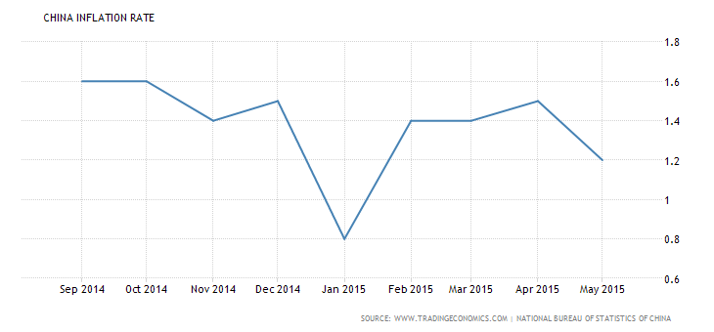
T3-T4 Bubble Burst: Macroeconomics perspective
China Monthly Inflation Rate (Sep 2014 to June 2015)
Introduction
Background information
Theories & Analysis
Reflections & Conclusions

Slide 28
T3-T4 Bubble Burst: Behavioral Economics
- Individual decision-making point of view
Introduction
There is a fraction of investors whose risk aversion increases significantly as their wealth declines.
These investors are only willing to hold a risky asset as long as their wealth does not fall below a certain threshold.
As the price of the stock started to decline, investors become much more risk averse and less willing to hold risky stocks, so they began to sell.
Self-reinforcing cycle of deleveraging, falling asset prices, and collapsing liquidity.
Background information
Theories & Analysis
Reflections & Conclusions

Slide 29
T3-T4: Financial Economics perspective - Gordon Growth Model Revisited
Introduction
Background information
T3-T4:
- g is expected to decrease.
- P₀ goes down.
Theories & Analysis
Reflections & Conclusions
Notes:
Myron J. Gordon.

Slide 30
T3-T4: Financial Economics perspective - Minsky’s financial Instability Hypothesis cont.
Introduction
Minsky moment:
When the market grows to a level that can’t provide enough returns for some indebted people to cover their cost of borrowing
➡ they sell their assets to repay
➡️ a fall in the price
➡️ the market become less attractive
➡️ more sellers and fewer buyers
➡️ price collapses (the bubble busts and problems like illiquidity emerge in the financial system).
Our opinion: Irrational use of leverage causes financial instability.
Background information
Theories & Analysis
Reflections & Conclusions

Slide 31
T3-T4: Detrimental elimination of Leverage
Introduction
An Automatic stop-loss order will be forced by a financial institution (securities companies, P2P) providing the leverage when the margin (equity/assets) of an account falls below the maintenance margin and the borrower can’t add money to his or her account.
➡️ A plunge in the price initially result in Huge stop-loss orders
➡️ the market price drop at a astonishing rate because of those sell orders
➡️ more accounts using leverage are below the maintenance margin
➡️ stop-loss orders continues…
Background information
Theories & Analysis
Reflections & Conclusions

Slide 32
T4-T5:
T3: 2015.06.12
Introduction
De-leverage
Market rescue
T4: 2015.07.08
Background information
Central bank cut rates again
T2: 2015.03.01
T5: 2015.08.31
Theories & Analysis
Central bank cut rates
Futures market shut down
T1: 2014.11.26
Reflections & Conclusions
Source: tradingeconomics.com
Notes:
第一次降息
第二次降息
去杠杆
救市 补充流动性
去futures contract, avoiding short sell.

Slide 33
T4-T5: Macroeconomics perspective – Market Rescue
Introduction
The central bank: required reserve ratio dropped 25-50 basic points.
Chinese Securities Regulatory Commission:
Controlled (and then stopped) initial public offerings.
Limited short selling.
Imposed a six-month ban on stockholders owning more than 5 percent of a company's stock from selling those stocks. The government also provided cash to brokers to buy shares, backed by central-bank cash.
21 securities companies announced to buy 120 billion yuan of ETF.
But the policies were effective for a while but not enough to stop the stock market from dropping further.
To end a selloff that has eroded confidence in the economy and to stop the speculation, Chinese policy makers decided to shut down the futures market.
Selling the contracts is one of the easiest ways for investors to make large wagers against stocks.
The contracts are also attractive to short-term speculators because the exchange allows participants to buy and sell the same contract in a single day.
Background information
Theories & Analysis
Reflections & Conclusions
Notes:
An ETF, or exchange traded fund, is a marketable security that tracks an index, a commodity, bonds, or a basket of assets like an index fund. Unlike mutual funds, an ETF trades like a common stock on a stock exchange.

Slide 34
T4-T5: Behavioral Economics
Introduction
Given the risk aversion, these traders want to insure themselves against this price decline.
How? Employ a dynamic hedging strategy that replicates a call option payoff structure. This dynamic trading strategy requires the investor to sell stocks when the price is falling and buy stocks when it is rising.
These sales lead to an even larger price decline.
Background information
Theories & Analysis
Reflections & Conclusions

Slide 35
T4-T5: Financial economics perspective –
Futures Market Shut Down
Introduction
Influences of futures market:
One crucial function of futures market: hedgers are essentially trying to protect themselves and their business against unfavorable movement of the market price in the future.
When the market is experiencing a hard time, fund managers would want to hedge their portfolios against further plunge in the price by shorting futures contract.
Massive shorting will drive the futures’ price down to a level much lower than the the spot market price.
Based on the huge spread between futures market price and spot market price, retail investors, who dominate the Chinese stock market, would expect the market price to drop.
As a result of such expectation, there were more sellers than buyers. => further decrease in the market price.
On August 31, the futures market was shut down.
Background information
Theories & Analysis
Reflections & Conclusions

Slide 36
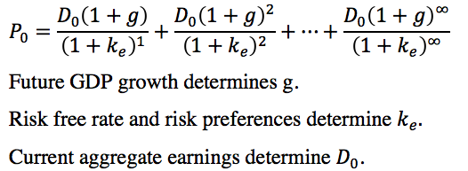
Reflections
Introduction
How do you know you are in a bubble?
Rational valuation of the stock market based on several key factors: current aggregate earnings, future GDP growth, risk-free interest rate, the risk preferences.
Gordon growth model:
Our opinion: if the current market price is above the relatively optimistic valuation(relatively high future GDP growth, relatively low risk free rate and relatively low level of risk aversion), we have to be alert.
Background information
Theories & Analysis
Reflections & Conclusions

Slide 37
Reflections cont.
Introduction
How can we prevent the problem of irrational exuberance?
The government should…
Limit the capital flows into stock market.
More rigid restrictions on leverage using (for borrowers). Supervise those leverage providers strictly. E.g.: leverage using taxes;
Encourage the media to provide objective, accurate, authentic information related to the stock market.
Risk management.
Balance sheet vulnerabilities (institutional investors)
Manage market failure problems.
Background information
Theories & Analysis
Reflections & Conclusions
Notes:
Mispresentation of the real conditions in the stock market.
Institutional investors are subject to BS vulnerability; Leverage Ratio (Equity/Debt) too high: equity is very vulnerable to undesirable movement of the market price.

Slide 38
Questions?

