Slide 1
Economics of Virtual Currency
Genway Huang
ECON 4905
March 21, 2016

Slide 2
Overview
Background
What is Bitcoin?
Value of Bitcoin
Bitcoin Market Today
Conclusions

Slide 3
Background
Commerce online is a trust-based system reliant on financial institutions as a third-party. Third party verifies to avoid double-spending problem.
Banks transfer money cheaply and electronically.
Currency differs from country to country.
Additional costs when mediating disputes. Reversible transactions make trust a necessity in online.
Not the same as cash, transactions are traced.

Slide 4
What is Bitcoin?
Proposed as a solution of “an electronic payment system based on cryptographic proof instead of trust, allowing any two willing parties to transact directly without the need for a trusted third party” ¹
Peer-to-peer timestamp server using public ledger Blockchain.
Download Bitcoin wallets and obtain coins by transactions.
But must solve double-spending problem to have any level of credibility.

Slide 5
Proof-of-work: Byzantine Generals’ Problem
Byzantine army has several divisions each with its own general. There are traitors among the generals.
Attack timing is communicated through messengers.
Messengers arrive at different generals at different times with possibly conflicting attack times (traitors try to confuse things).
Attack will only be successful if majority of generals attack together.
Proof-of-work system is Bitcoin’s solution to the Byzantine failures.

Slide 6
Proof-of-work: Byzantine Generals’ Problem
When a general receives a attack time he must solve a complicated proof-of-work problem using the attack time.
Difficult problem takes time to solve, and when a general solves problem it is broadcasted to network. Everyone changes current proof-of-work computation to include that one.
Anyone working on a different attack time switches to that one because proof-of-work chain is longer.
Every general, by verifying difficulty of proof-of-work chain to estimate how much CPU power per hour expended on it to confirm if majority of computers required to have produced that much proof-of-work.

Slide 7
Bitcoin Mining
What the generals have done is bitcoin mining, i.e. adding transaction records to the public ledger.
Difficulty of problem is adjusted so that expected time (about 10 minutes per block) to find each solution is about the same to compensate for increased computing power or varying interest in running nodes.
This solves double-spending since if you wait long enough for the confirmation of the chains, the transaction is finalized.

Slide 8
Incentive of Mining
Miners that solve the problem are rewarded with a transaction fee as incentive with newly created coins.
If someone manages to acquire more than half of all the computing power, they could reverse transactions, i.e. double-spend or refuse to validate transaction. This would destroy the value of bitcoin.
In best interest to not one-shot undermine system of his own wealth, especially with steady stream of income from mining not to mention huge investment to acquire specialty hardware designed to solve Bitcoin problems, CPU time, and power.

Slide 9
Value of Bitcoin
Recall red-money, blue-money and with P^{m}, the price of money in terms of goods
The value of bitcoin in terms of goods and services and the value of other currency like US dollars can be used to determine the exchange rate and how Bitcoin is valued.
New territory, how to tax? Federal tax purposes virtual currency is treated as property. ¹

Slide 10
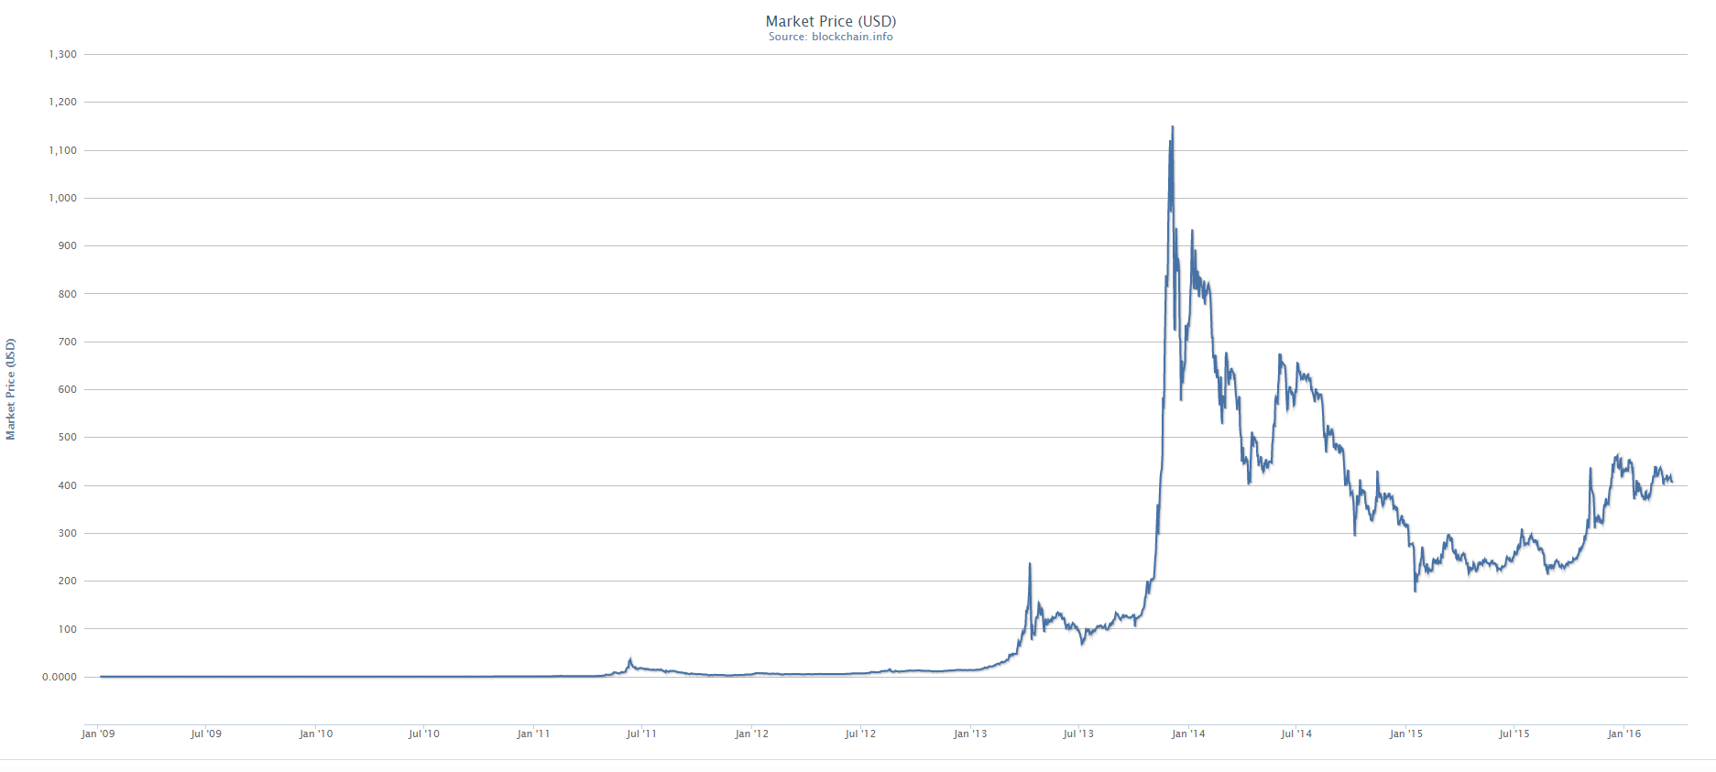

Slide 11
Value of Bitcoin
Money is: store of value, unit of account, medium of exchange
As a store of value, it is very volatile especially in long term graph where we see the huge spike in 2013 where skyrocketed followed by a series of ups and downs. ¹
Not regulated and can be quite unpredictable.
Things that could disrupt confidence: Government crackdown, superior competing currency, deflationary spiral. ²

Slide 12
Bitcoin Market Today
More and more places are accepting Bitcoin.
Some venues not so upstanding. Criminal activity, black markets like Silk Road that was shut down by FBI in 2013.
https://blockchain.info/stats: Lots of mining and trading with Bitcoin
Bitcoin hedge funds: Global Advisors Bitcoin Investment Fund, Pantera Capital, Bitcoins Reserve, Binary Financial, Coin Capital Partners, Falcon Global Capital
These trade on volatility, on arbitrage, buy-and-hold, venture capital, etc. lots of ways of investment into Bitcoin.

Slide 13
Conclusions
Innovative currency that has a lot of potential benefits: anonymity, no transaction limits, micro payments, competition as payment platform, etc.
Risks such as volatility of the value of currency.
Money laundering and criminal activity implications make it a target for government regulation.
Mining is a huge cost. While designed to be so, a lot of computing power and energy used.

Slide 14
Questions and Discussion

Slide 15
Works Cited
Dwyer, Gerald P. “The Economics of Bitcoin and Similar Private Digital Currencies” (May 8, 2014). Munich Personal RePEc Archive. https://mpra.ub.uni-muenchen.de/id/eprint/55824
Garratt, Rod. “Are Virtual Currencies For Real?” Wisconsin School of Business 6th Annual Conference on Money, Banking and Asset Markets (December 13, 2014).
Grinberg, Reuben. “Bitcoin: An Innovative Alternative Digital Currency” (December 9, 2011). Hastings Science & Technology Law Journal, Vol. 4, p.160. http://ssrn.com/abstract=1817857
Internal Revenue Service. “Notice 2014-21” (April 14, 2014). https://www.irs.gov/irb/2014-16_IRB/ar12.html
Nakamoto, Satoshi. “Bitcoin: A Peer-to-Peer Electronic Cash System” (2008). https://bitcoin.org/bitcoin.pdf
Rosenfeld, Meni. “Analysis of Bitcoin Pooled Mining Reward Systems” (November 17, 2011). https://bitcoil.co.il/pool_analysis.pdf

