Slide 1
The Transactions Demand For Cash: An Inventory Theoretic Approach
William J. Baumol

Slide 2
Bed Bath and Beyond Cash Management Practices Prior to 2008 Financial Crisis

Slide 3
Examining the connections between inventory theory and monetary theory
Cash can be thought of as its holder’s inventory of the medium of exchange
Similar to a commodity
Serves as possessor’s part of the bargain in an exchange
It follows that inventory control analysis can be applied to the theory of money and business cycle theory
George F. Mellen “Practical Lot Quantity Formula” Management and Administration (Sept. 1925)
Jacob Marschak “Optimal Inventory Policy” Econometrica (July 1951)

Slide 4
Setting up the (simple) model
Assume state with perfectly foreseen transactions that occur in a steady stream
Over this given period, individual will disburse T dollars in a steady stream
Cash is either borrowed or withdrawn from an investment; regardless, interest cost (or opportunity cost) is i dollars per dollar per period
Withdrawals are made in lots of C dollars spaced evenly throughout the year
Withdrawals are subject to a fixed “broker’s fee” of b dollars
Note: T is predetermined, and i and b are assumed constant throughout

Slide 5
Determining costs associated with the use of cash
Any value of C less than or equal to T will enable individual to meet his payments (assuming sufficient withdrawals through period)
Individual will make T/C withdrawals over the course of the year
Total cost of broker’s fees is given by bT/C
Average cash holdings through period given by C/2 dollars
Remember: C dollars are spend in stead stream, and a similar amount is withdrawn as soon as cash on hand is exhausted
Interest cost (annualized) is given by iC/2
Logically, total amount individual must pay for use of the cash to meet his transactions when he borrows C dollars evenly throughout the year is given by:
bT/C + iC/2 (sum of interest cost and brokers’ fees)

Slide 6
Establishing the most economical value of C
Individual has desire to minimize cost of paying for transactions, remains indifferent to how he meets his payments
Thus, take the derivative of: bT/C + iC/2 (cost of using money)
- bT/C2 + i/2 = 0, i.e.;
C = $\frac{\sqrt{2bT}}{i}$
Assuming constant price level, individual will demand cash in proportion to the square root of the value of his transactions
This applies to cases where:
Individual (or firm) obtains cash from invested capital
Individual (or firm) spends out of borrowing in anticipation of future receipts
Even in cases where receipts precede expenditures, general nature of results is unaffected

Slide 7
Implications and consequences of transaction demand for cash in a steady state
“Steady state”
Definition: an economy made up of a constant population size and a constant stock of physical wealth (capital); usually applies to nations but can apply to cities, regions, or the world
Assuming steady state, monetary theorists will argue results indicate that no demand for cash balances should exist
Profitable to invest all earnings in assets with positive yield that will be realized at the moment payments are made
Given lack of demand, value of money demand will fall to zero
However, this argument neglects ‘brokers fees’; model is compatible with static view: it pays to keep some cash

Slide 8
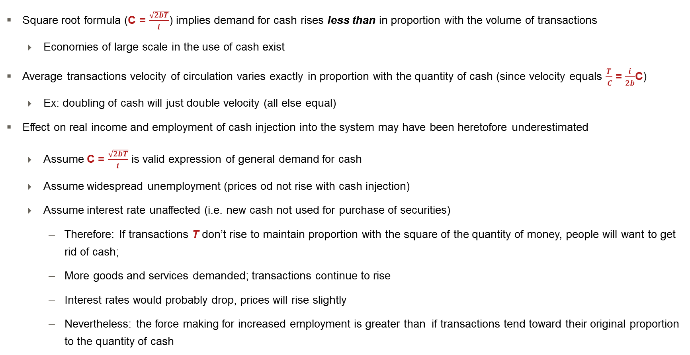
Model implications (continued)
Square root formula (C = $\frac{\sqrt{2bT}}{i}$) implies demand for cash rises less than in proportion with the volume of transactions
Economies of large scale in the use of cash exist
Average transactions velocity of circulation varies exactly in proportion with the quantity of cash (since velocity equals $\frac{T}{ C}$ = $\frac{i}{2b}$C)
Ex: doubling of cash will just double velocity (all else equal)
Effect on real income and employment of cash injection into the system may have been heretofore underestimated
Assume C = $\frac{\sqrt{2bT}}{i}$ is valid expression of general demand for cash
Assume widespread unemployment (prices od not rise with cash injection)
Assume interest rate unaffected (i.e. new cash not used for purchase of securities)
Therefore: If transactions T don’t rise to maintain proportion with the square of the quantity of money, people will want to get rid of cash;
More goods and services demanded; transactions continue to rise
Interest rates would probably drop, prices will rise slightly
Nevertheless: the force making for increased employment is greater than if transactions tend toward their original proportion to the quantity of cash

Slide 9
Sanity check of the transactions demand for cash model and its implications
Suggestive over-simplification, given rationality assumptions in its derivation
Static model
Assumes distribution of firm’s disbursements are fixed
Assumes constant, relevant rate of interest
Constant (or linear) brokers’ fee
Posits steady stream of payments and absence of cash receipts during relevant period
Only deals with cash demand of single economic unit, ignores various demands for cash in the economy
Neglects precautionary and speculative demands or cash

Slide 10
Areas of further study identified by the transactions demand for cash model
While it may not be practical to effect for the public to effect every possible economy in use of the cash, it may be profitable for largest cash users to reduce cash balances relevant to transactions
This can have system-wide repercussions that are significant and material
Small cash holders may be incentivized to realize cash economies by instinct or by trial and error
The non-zero rational transactions demand for cash, and the less than proportionate rise in the rational demand for cash with the real volume of transactions depends on the responsiveness of:
The brokerage fee to the quantity of cash involved
Can’t fall below a pre-assigned level
The interest rate to the quantity of cash involved
Must have an upper bound, must not decrease as quantity of cash borrowed or invested increases
When cash payments are lumpy but foreseeable, cash may be employed even more economically; it is profitable to obtain cash just before large payments are due (which incurs minimal brokers' fees and saves considerable savings in interest payments)

Slide 11
Areas of further study identified by the transactions demand for cash model
The economy in a single person’s use of cash resulting from an increase in the volume of his transactions may or may not have its analogue for the economy as a whole
Rise in demand for brokerage services resulting from a general increase in transactions may cause brokers fee to increase, decrease visits to brokers, increase average cash balances
Widespread cash economizing might require an increase in precautionary cash holdings (friends less able to help, creditors less patient) which would weaken but not offset relative reduction in cash holdings
Difficult to assess precautionary and speculative demands for cash
An increase in the volume of transactions will make for economies in the use of cash for precautionary purposes by permitting increased recourse to insurance principles
A bank’s precautionary cash requirements might also grow as the square root of the volume of its transactions (Edgeworth 1888; Wicksell 1936)
Cash demands of a bank tend to be normally distributed, thus precautionary cash requirements should be met by keeping on hand a constant multiple of the standard deviation (above the mean) in order to avoid running out of funds

