Slide 1
How to Make Money
Building your Own Portfolio
Alexander Lin
Joey Khoury
Professor Karl Shell
ECON 4905

Slide 2
Agenda
Types of Stock
Fixed Income Securities
Portfolio Maximization and Macroeconomic Considerations

Slide 3
TYPES OF STOCK

Slide 4
Types of Stock
Common Stock vs. Preferred Stock
Indexes vs. ETFs vs. Mutual Funds
Commodities
REITs
Small, Mid-cap stocks and Blue chip stocks
Major Stock Exchanges vs. OTC Markets

Slide 5
Common Stock vs. Preferred Stock
Common Stock
Preferred Stock
Receives Dividends
Dividends not fixed
Voting power
Company liquidation – not guaranteed
Return on capital not guaranteed
Receives priority dividends
Dividends fixed
No voting power
Company liquidation – paid back first
Return on capital guaranteed – similar to bond
Generally more expensive – insurance premium
Common Stock < Preferred Stock < Junior Debt < Senior Debt

Slide 6
Why this is important to your portfolio
Common Stock vs. Preferred Stock
Cases:
1. High uncertainty – ’08
2. Risky Company – might be bought out. E.g. Twitter, Takata

Slide 7
Indexes vs. ETFs vs. Mutual Funds
Market Indices: is a measurement of the value of a section of the stock market. It is computed from the prices of selected stocks (typically a weighted average). It is a tool used by investors and financial managers to describe the market, and to compare the return on specific investments.
Value weighted or Capitalization weighted Ex. NADAQ and S&P
Price-weighted Ex. DJIA
ETFs: An ETF, or exchange traded fund, is a marketable security that tracks an index, a commodity, bonds, or a basket of assets like an index fund. Ex. SPDRs
Mutual Funds: A mutual fund is an investment vehicle made up of a pool of funds collected from many investors for the purpose of investing in securities such as stocks, bonds, money market instruments and similar assets. Ex. Vanguard

Slide 8
Why this is important to your portfolio
Arbitrage
Benchmarks
Diversification
Cases:
1. You believe the energy industry is growing and want overall exposure but don’t want to put your money in one company
2. You want people to actively manage your money but don’t have enough capital for banks to take you on as a client

Slide 9
Commodities
A raw material that can be bought or sold such as oil, gold, coffee, or chocolate

Slide 10
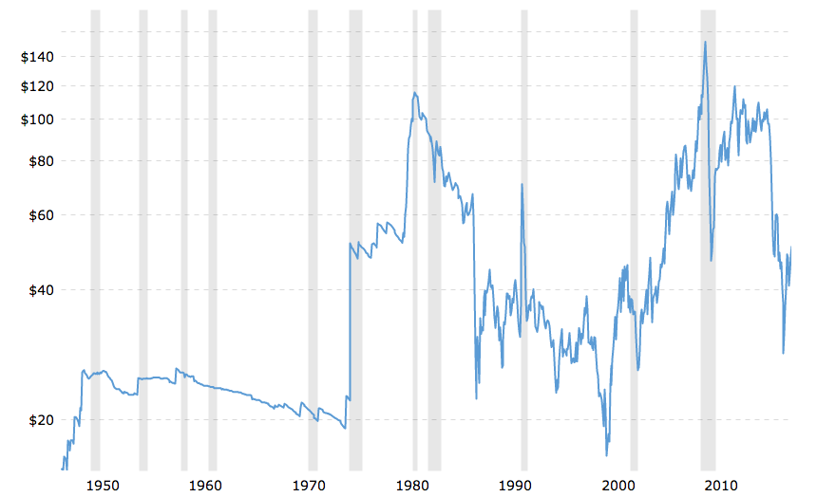
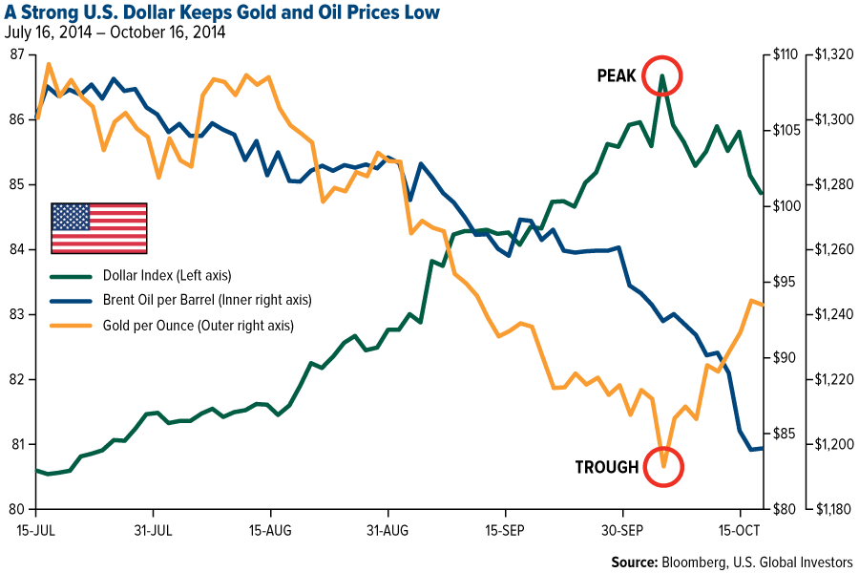
Why this is important to your portfolio
Futures hedge
Gold is technically a currency, and while it is priced in U.S. dollars, the value of the two currencies is roughly inversely correlated in the long term.
Gold tends to be the most successful when there is little faith in paper money and the stock market.

Slide 11
REITS
Type of company you can invest in
REITs own many types of commercial real estate, ranging from office and apartment buildings to warehouses, hospitals, shopping centers, and hotels

Slide 12
Why this is important to your portfolio
Strong dividends
Have to return 90% of their taxable income to investors in order to legally avoid federal taxes
Exposure to real estate market with experienced professionals selecting stocks for you
Way to diversify your portfolio while maintaining liquidity and using available capital

Slide 13
FIXED INCOME SECURITIES

Slide 14
Fixed Income Securities
Bonds
Bond Rating
Bonds: The nine main types of bonds:
“Plain Vanilla” Bond
Treasury bonds
Treasury-Inflation Protected Securities
Investment-Grade Corporate Bonds (high quality);
High-Yield Corporate Bonds (low quality), also known as junk bonds;
Foreign Bonds;
Mortgage-Backed Bonds
Municipal Bonds
Zero Coupon Bond
Bond Calling / Convertibility
Derivatives
Types of Derivatives
Swaps (CDS, Interest Rate Swaps, Inflation Swaps)
Interest Rate Futures
Forward rate agreements
Risks
inflation risk
interest rate risk
currency risk
default risk
reinvestment risk
liquidity risk
duration risk
convexity risk
credit quality risk
political risk
tax adjustment risk
market risk
event risk

Slide 15
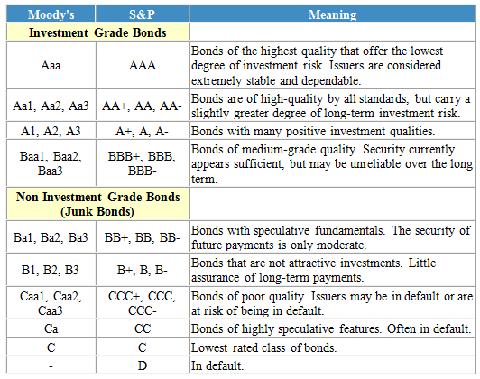
Bond Ratings

Slide 16
Bond 1 of 9: “Plain Vanilla” Bond
The term ‘Plain Vanilla’ signifies the most basic or standard version of a financial instrument, usually options, bonds, futures and swaps. In this case, we are discussing the most basic version of a bond before discussing Bonds 2-9.
A Vanilla bond is a bond that pays interest at regular intervals, and at maturity pays back the principal that was originally invested.
Four key parts: Coupon Payment, Interest Rate, Full Face Value and Maturity.
The bond has a face value, usually $1,000. The interest rate on the bond is the percent of face value that will be given to the investor on an annual or semiannual period. The money received from the bond’s interest is the coupon payment. With a 1% interest payment on a bond with Face Value of $1,000 the investor will receive a $10 coupon payment. The maturity is the life of the bond, and is essentially the number of years in which the investor will receive Coupon Payments. In our example, a bond with a 5 year maturity will pay 1% interest rate, or $10 coupon payment, to the bondholder every period for 5 years. At the end of the bond’s maturity, the bondholder will receive the face value of the bond in one lump sum payment of $1,000 plus interest.

Slide 17
Bond 2 of 9: Treasury Bonds
Also Called T-Bond, the U.S. Treasury Bond is defined as a marketable, fixed-interest U.S. government debt security with a maturity of more than 10 years.
The Treasury Bond is one of four types of debts issued by the U.S. Government to reduce the money supply during times of contractionary monetary policy. The other three debts issued are Treasury bills, which have less than one year maturity; Treasury notes, which have a maturity between one and ten years; and Treasury Inflation-Protected Securities (TIPS), which will be discussed shortly.

Slide 18
Why This is Important for Your Portfolio
Treasury Bonds are considered the safest investment of all.
Treasuries are backed by “the full faith and credit” of the U.S. government. As a result, the risk of default on these fixed-income securities is next to nothing.
Since the initial formation of the government in 1776, the U.S. Treasury has never failed to pay back its lenders.
This is especially important because Treasury Bonds are what we will call the riskfree asset when we discuss portfolio optimization near the end of our presentation.

Slide 19
Bond 3 of 9: Treasury Inflation Protected Securities (TIPS)
This subset of Bonds includes inflation linked bonds issued by the U.S. Government, namely Treasury Inflation Protected Securities, or TIPS.
TIPS are a treasury security that is indexed to inflation in order to protect investors from the negative effects of inflation. It promises interest-adjusted constant payments. In other words, the bond’s par value rises or falls with inflation measured by the Consumer Price Index (CPI).

Slide 20
TIPS Example
T=1, C=1%, i=0 | T=2, C=1%, i=2% | T=3, C=1%, i=-5%
Par Value = 1000 | Par Value= 1020 | Par Value = 950
Payment= 10 | Payment=10.20 | Payment 9.50
Suppose an investor owns $1,000 in TIPS at the end of the year, with a coupon rate of 1%. If there is no inflation as measured by the CPI, the investor will receive $10 over the year in coupon payments. If inflation rises by 2%, however, the $1,000 principal will be adjusted upward by 2% to $1,020. The coupon rate will still be the same at 1% but it will be multiplied by the new principal amount of $1,020 to get an interest payment of $10.20. On the other hand, if inflation was negative, as in deflation, with prices as measured by the CPI falling 5%, the principal would be adjusted downward to $950. The resulting interest payment would be $9.50 over the year.

Slide 21
Why This is Important for Your Portfolio
TIPS are among the safest class of fixed income securities because they are also backed by the full faith of the U.S. Treasury- there is no default risk. However, they are even more protective in nature because they hedge your risk against inflation (as well as the risk of default).
For beginner investors, TIPS are what we advise investing in. The constant rate of return, along with the measurable risk (indicated by the CPI’s measure of inflation) makes your earnings from TIPS accurately predictable.

Slide 22
Bond 4 of 9: Investment-Grade Corporate Bonds
Similarly to how the U.S. Government can sell bonds, so can a corporation. When a corporation issues bonds, it is usually an unsecured debt- there is no collateral. In essence, a bond issued by a corporation is an IOU sold at below the full par value. Usual demonization's are in 1,000 or 5,000 increments.
As seen in the Bond Rating slide, Investment Grade Bonds are defined as those above the BBB rating.

Slide 23
Why This is Important for Your Portfolio
Investment Grade Corporate Bonds offer a risk-return structure that is more heavily weighted for the risk adverse investor. AAA bonds are of little risk and little return; over long periods of time they can prove to be handsomely rewarding with reinvestment through the years. BBB bonds may not be as secure as AAA, but have a little higher return to compensate.
For a young investor wishing to pursue a non-aggressive strategy to building a portfolio, investment grade bonds are a great way to build wealth over long periods of time.

Slide 24
Bond 5 of 9: High-Yield Corporate Bonds (AKA junk bonds)
Junk bonds function the same as any other bond; the difference is just in their credit rating.
Junk bonds are typically rated 'BB' or lower by Standard & Poor's and 'Ba' or lower by Moody's.
Junk Bonds pay high yield to bondholders because the borrowers (the corporations) don't have any other option. Their credit ratings are too low to acquire capital at an inexpensive cost.
Junk Bonds can be broken into two types:
Fallen Angels - This is a bond that was once investment grade but has since been reduced to junk-bond status because of the issuing company's poor credit quality.
Rising Stars - The opposite of a fallen angel, this is a bond with a rating that has been increased because of the issuing company's improving credit quality. A rising star may still be a junk bond, but it's on its way to being investment quality.

Slide 25
Why This is Important for Your Portfolio
Junk Bonds offer higher yields than risk free assets and higher yields than minimally risky assets (like AAA Corporate Bonds).
If you have limited time to invest, want to pursue an aggressive investment strategy, or have a high tolerance towards risk, then Junk Bonds may be something to consider for your portfolio; especially if you believe you’ve found a Rising Star

Slide 26
Bond 6 of 9: Foreign Bonds
A foreign bond is a bond issued in a domestic market by a foreign entity in the domestic market's currency as a means of raising capital.
Example: Bulldog Bond- issued by non-British institutions that want to sell the bond in the United Kingdom.
Example: Samurai Bond- issued by non-Japanese institutions that want to sell the bond in Japan.

Slide 27
Why This is Important for Your Portfolio
Since investors in foreign bonds are usually the residents of the domestic country, investors find the bonds attractive because they can add foreign content to their portfolios without the added exchange rate exposure.
Foreign Bonds are subject to regulation of the domestic market in which they are issued. For example, a samurai bond is a yen-denominated bond issued in Tokyo by a non-Japanese company and subject to Japanese regulations. If you are investing in a company that will succeed by taking advantage of the difference in Tokyo’s regulations, you would want to consider investing in these bonds.
If you believe that the strength of the foreign nation’s currency will become increasingly stronger in the next few years, you may also consider investing in these bonds. At the maturity date, a bond worth X Yen at the height of Japan’s economy is worth more than X Yen at the trough of Japan’s economy since the value of the Yen will be stronger.

Slide 28
Bond 7 of 9: Mortgage-Backed Bonds
Subset of Mortgage-Backed Securities (MBS)
These are types of bonds representing an investment in a pool of real estate loans.
They are especially a tool used by banks to free up capital and allow investors to profit off of bundled mortgages.
How these work:
The bank sells hundreds or thousands of mortgage debt at discount to an investment bank in order to free the money held up the life of the mortgage. The IB then bundles the mortgages into tranches and then issues them for sale. The homeowner’s mortgage payments really go to the IB, not the bank.

Slide 29
Why This is Important for Your Portfolio
This could cause the world to collapse (2008).
In theory, this is supposed to be a secure investment. The first bill that people pay is their mortgage. It is considered the most important debt that each person has. As long as homeowners pay their mortgage, everything *should be* fine.
As we have seen with the market collapse of 2008, this investment strategy has more risks than traditional bonds. Since the Investment Bank is issuing the bonds, they are subject to 1) the rating industry keeping a close eye on how these mortgages are preforming, 2) the loan originators and whether or not new mortgages are feasible to pay off.

Slide 30
Bond 8 of 9: Municipal Bonds
Let us first define a Municipality as a city or town that has corporate status and local government.
Therefore, a Municipal Bond is simply a bond issued by a Municipality. In context this is simply a bond issued by a state, city, or county to finance capital expenditure like the construction of highways, bridges, or schools.
Typically, municipal bonds have a minimum denomination of $5,000, but some issuers may impose a higher minimum denomination, most commonly in the amount of $100,000.

Slide 31
Why This is Important for Your Portfolio
Municipal bonds are exempt from federal taxes and from most state and local taxes, making them especially attractive to people in high income tax brackets.
They are secured by the faith of the municipality, which typically has less corruption than corporations*
* Municipalities do not have shareholders like corporations do, and thus have a lot less incentive to forge accounting. The state and city may receive funding from taxation in accordance with the state law.
As an investor, you are investing in the betterment of your state and local areas. This, in the long run, can improve assets you may already own such as your home value.
Ex: Great infrastructure and a stellar school district (funded through M Bonds within your hometown) will increase the value of your property.

Slide 32
Bond 9 of 9: Zero Coupon Bond
A zero-coupon bond doesn't pay interest (a coupon) but is traded at a deep discount, giving profit at maturity when the bond is redeemed for its full face value.
EX: Buying a ZCB of FV=1,000 with YTM 2yrs for 890 = 110 Profit
Think of it as one lump sum payment in X years with imputed interest (interest is within the calculated future value price)
$PV=\frac{FV}{{\left(1+r\right)}^{T}}$

Slide 33
Why This is Important for Your Portfolio
Zero Coupon Bonds are predictable, and generally a safe bet. You will not receive coupon payments and thus will not have generated a new cash flow with them, but at maturity you will receive a large lump sum that you payed only a fraction for.
ZCB are very often used in the immunization of debts from interest rates. Suppose an investor needs to pay a $10,000 obligation in five years. To immunize against this definite cash outflow, the investor can purchase a security that guarantees a $10,000 inflow in five years. A five-year zero-coupon bond with a redemption value of $10,000 would be suitable. By purchasing this bond, the investor matches the expected inflow and outflow of cash, and any change in interest rates would not affect his ability to pay the obligation in five years.

Slide 34
Bond Convertibility
As a way to add security to the debt, some bonds offer the bondholder the ability to convert the value of the bond into stock shares of the borrowing corporation.

Slide 35
Fixed Income Securities
Bonds
Bond Rating
Bonds: The nine main types of bonds:
“Plain Vanilla” Bond
Treasury bonds
Treasury-Inflation Protected Securities
Investment-Grade Corporate Bonds (high quality);
High-Yield Corporate Bonds (low quality), also known as junk bonds;
Foreign Bonds;
Mortgage-Backed Bonds
Municipal Bonds
Zero Coupon Bond
Bond Calling / Convertibility
Derivatives
Types of Derivatives
Swaps (CDS, Interest Rate Swaps, Inflation Swaps)
Interest Rate Futures
Forward rate agreements
Risks
inflation risk
interest rate risk
currency risk
default risk
reinvestment risk
liquidity risk
duration risk
convexity risk
credit quality risk
political risk
tax adjustment risk
market risk
event risk

Slide 36
Derivatives
A derivative is a type of security. It is a contract between parties whose price is derived from the value of one or many underlying assets (such as: stocks, bonds, currencies, commodities, interest rates and market indices).
There are three main types of derivatives that we will cover: Swaps, Futures, and Forwards.

Slide 37
Swaps
A swap is an agreement between two parties to exchange sequences of cash flows for a set period of time.
There are three main types of swaps that we will cover: Credit Default Swaps, Interest Rate Swaps, and Inflation Swaps.

Slide 38
Credit Default Swaps
A credit default swap (CDS) is in effect an insurance policy on the default risk of a bond or loan. To illustrate, the annual premium in July 2012 on a 5-year German government CDS was about 0.75%, meaning that the CDS buyer would pay the seller an annual premium of $.75 for each $100 of bond principal. The seller collects these annual payments for the term of the contract but must compensate the buyer for loss of bond value in the event of a default.
2008: CDS upon MBS

Slide 39
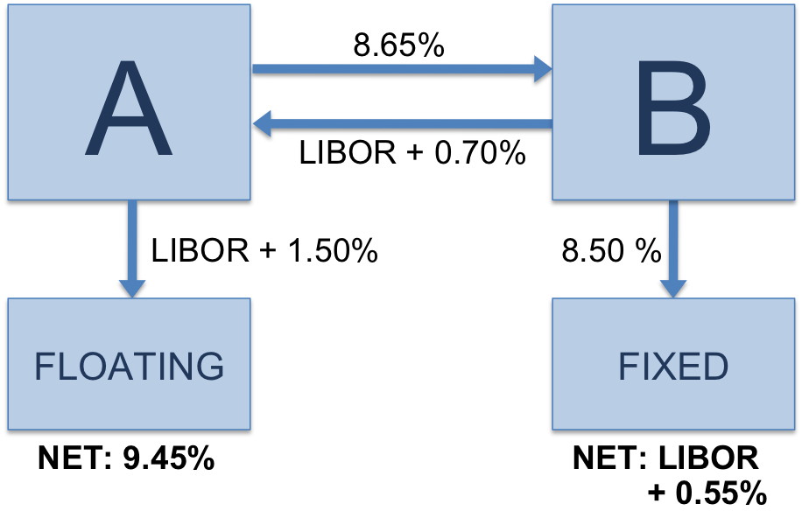
Interest Rate Swaps
Two parties agree to exchange interest rate cash flows, based on a specified notional amount from a fixed rate to a floating rate (or vice versa) or from one floating rate to another.

Slide 40
Inflation Swaps
An inflation swap is a swap that is used to transfer inflation risk from one counterparty to another through an exchange of cash flows.
An example to clarify:
Suppose an investor purchasing commercial paper. At the same time, the investor enters into an inflation swap contract, in which he receives a fixed rate and pays a floating rate linked to inflation. By entering into an inflation swap, the investor effectively turns the inflation component of the commercial paper from floating to fixed. The commercial paper gives the investor real LIBOR plus credit spread plus a floating inflation rate, which the investor exchanges for a fixed rate with a counterparty.

Slide 41
Futures
A contract where the buyer is agreeing to buy something that a seller has not yet produced for a set price.
Great in reducing unwanted risk
Futures markets are very liquid
Markets very volatile which exacerbates the fact that many futures contracts are highly leveraged

Slide 42
Commodity Futures
A commodity futures contract is an agreement to buy or sell a predetermined amount of a commodity at a specific price on a specific date in the future.
Buyers use such contracts to avoid the risks associated with the price fluctuations of a futures' underlying product or raw material.
Sellers use futures contracts to lock in guaranteed prices for their products.

Slide 43
Interest Rate Futures
A borrower will enter to sell a future today. Then if interest rates rise in the future, the value of the future will fall (as it is linked to the underlying asset, bond prices), and hence a profit can be made when closing out of the future (i.e. buying the future).
Forward Rate Agreement (FRA)
A company agrees to pay the different between the current market rate and the specified interest rate to hedge against interest rate risk.

Slide 44
Fixed Income Securities
Bonds
Bond Rating
Bonds: The nine main types of bonds:
“Plain Vanilla” Bond
Treasury bonds
Treasury-Inflation Protected Securities
Investment-Grade Corporate Bonds (high quality);
High-Yield Corporate Bonds (low quality), also known as junk bonds;
Foreign Bonds;
Mortgage-Backed Bonds
Municipal Bonds
Zero Coupon Bond
Bond Calling / Convertibility
Derivatives
Types of Derivatives
Swaps (CDS, Interest Rate Swaps, Inflation Swaps)
Interest Rate Futures
Forward rate agreements
Risks
Options vs. Puts
Convexity risk
Inflation Risk
Duration Risk

Slide 45
Options
Put option - Put options give the option to sell at a certain price, so the buyer would want the stock to go down.
In the money – market price is below the strike price
Call option - Call options give the option to buy at certain price, so the buyer would want the stock to go up
In the money – market price is above the strike price

Slide 46
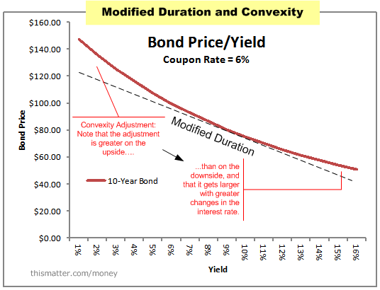
Convexity

Slide 47
Inflation Risk
Riskiness due to exposure to inflation
Risk that cash flows from an investment won't be worth as much in the future because of changes in purchasing power due to inflation.
For example, $10,000 in bonds with a 10% coupon might generate a decent nominal return, but with an annual 3% inflation rate, every $1,000 produced by the portfolio will only be worth $970 next year and about $940 the year after that.

Slide 48
Duration Risk
Longer the duration the greater the interest rate risk
Duration is a measure of the sensitivity of the price of a fixed-income investment to a change in interest rates
Coupon | YTM | period | cash flow | PV of CF | weight | W*t
0.04 | 0.1 | 1 | 40 | 36.36363636 | 0.042741081 | 0.042741081
 |  | 2 | 40 | 33.05785124 | 0.038855528 | 0.077711056
 |  | 3 | 1040 | 781.3673929 | 0.918403391 | 2.755210173
 |  |  |  | 850.7888805 | 1 | 2.87566231

Slide 49
Other Risks Include…
currency risk
default risk
reinvestment risk
liquidity risk
credit quality risk
political risk
tax adjustment risk
market risk
event risk

Slide 50
BUILDING YOUR PORTFOLIO WITH A MACRO PERSPECTIVE

Slide 51
Things to Consider:
Your Risk Tolerance
Current and Future Income
Interest Rate Growth
Employment Rates
Expected Inflation
Current Monetary / Fiscal Policy
Merging Markets (Example: The Tech Industry & Medicine)
International Competition
Currency Exchange (especially if investing in foreign assets)
Major Catalysts
Brexit
The Election
Political Climate

Slide 52
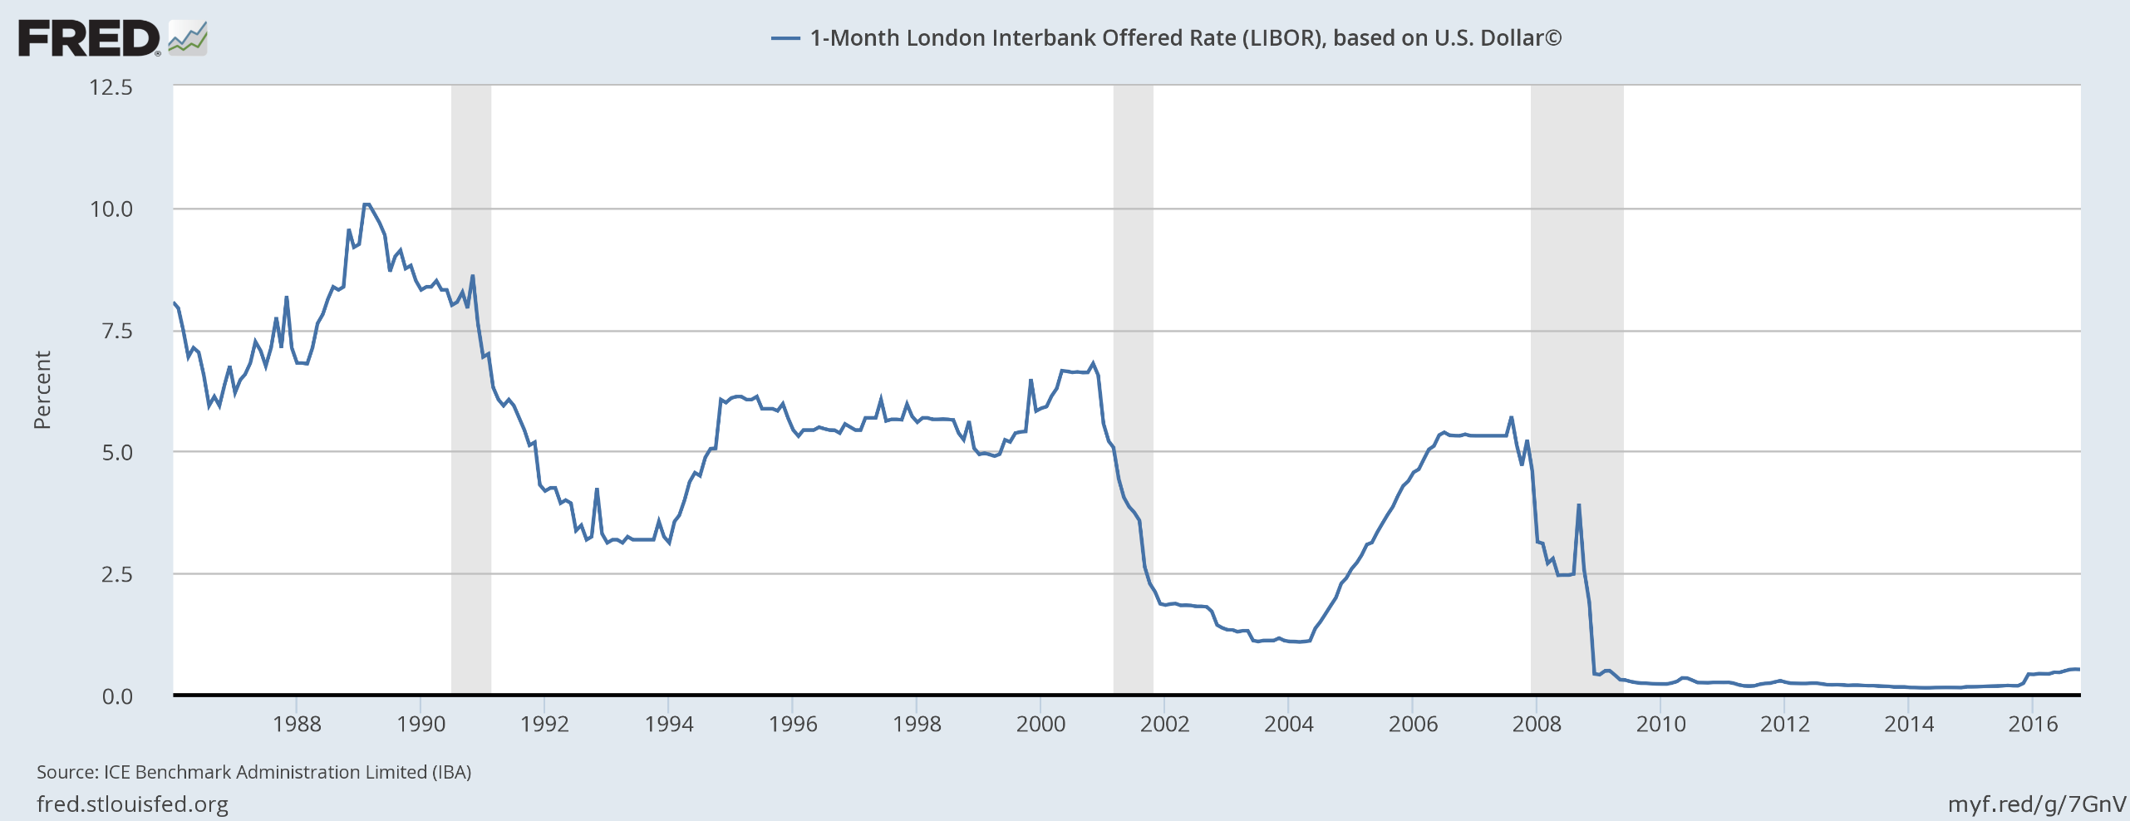
The LIBOR Rate 1988-2016 (interest rates)

Slide 53
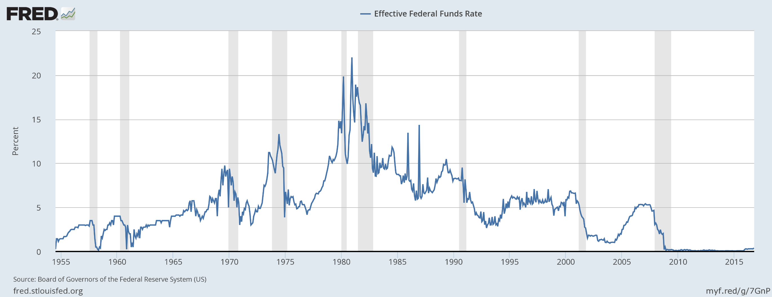
Fed Funds Rate 1955-2016 (Interest Rates)

Slide 54
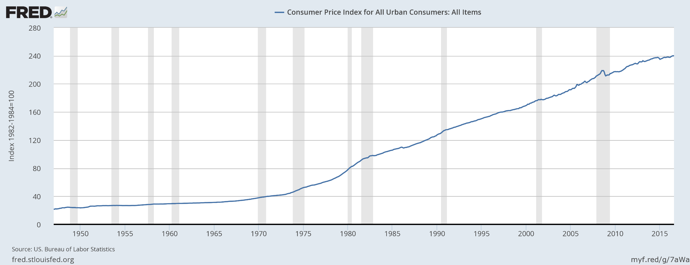
CPI 1950-2016 (inflation)

Slide 55
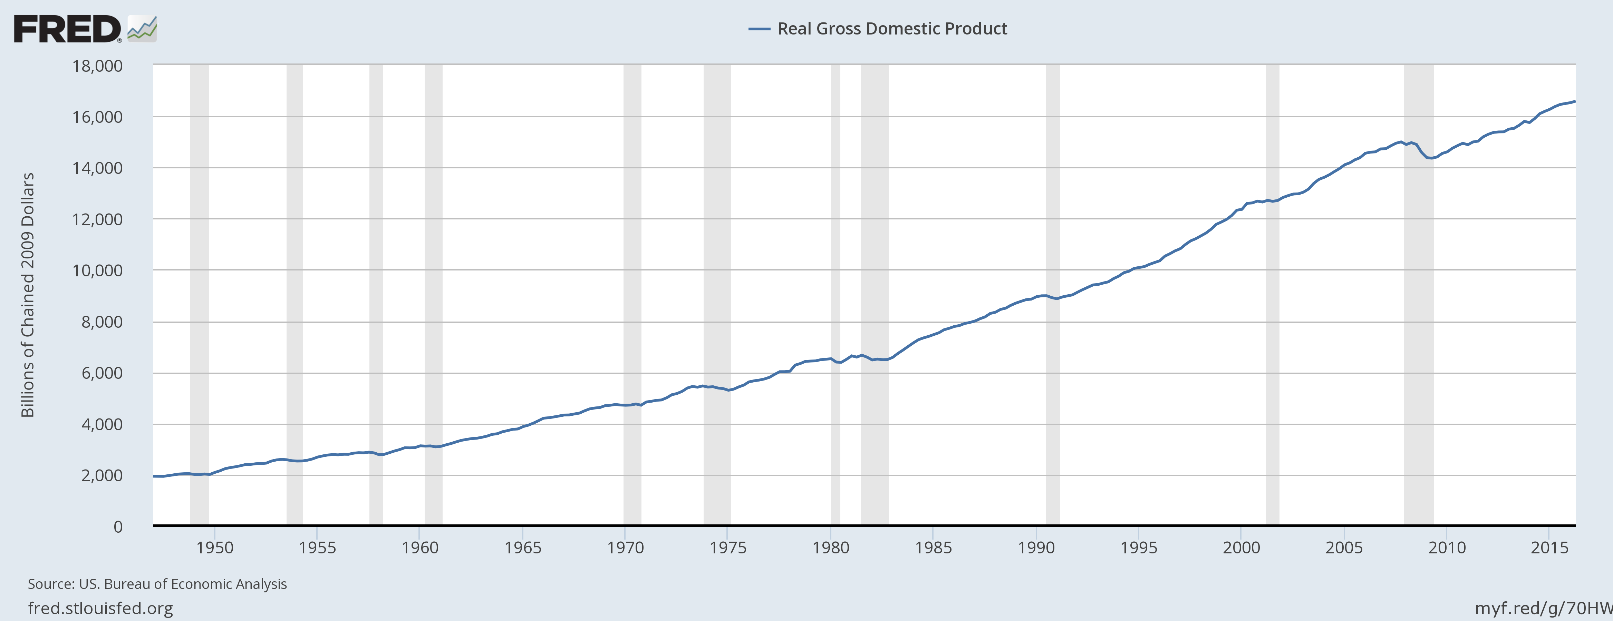
GDP 1950-2016

Slide 56
PORTFOLIO MAXIMIZATION

Slide 57
Conclusion: Portfolio Maximization
Every investment that we have covered can be labeled as either risky or risk free. The question now becomes, how can you maximize your utility for a given portfolio that is composed of risky and risk free assets?

Slide 58
The Optimum Weight of Risky Assets in a Portfolio
$$Max U(E\left(rc\right),δ^{2})=E\left(rc\right)−1/2A{δc}^{2}$$
$E\left(rc\right)$ = $π E\left(rR\right)$ + (1-$π$) $E\left(rf\right)$
${δc}^{2}$= Var($π$r_{R} + (1‐ $π$)r_{f})
${δc}^{2}$= Var($π$r_{R}) = $π$²σ_{R}²
$δc$= $π$σ_{R}
$$Max U(E\left(rc\right),δ^{2})=π E\left(rR\right)\text{ + (1-}π\text{) }E\left(rf\right)−1/2Aπ \text{2}\text{σ}\text{R}\text{2}$$
$$Max U\left(E\left(rc\right),δ^{2}\right)=π E\left(rR\right)\text{ +} E\left(rf\right) \text{-}πE\left(rf\right)−1/2Aπ \text{2}\text{σ}\text{R}\text{2}$$
$\frac{∂U}{∂π}=E\left(rR\right)$ - $E\left(rf\right)$ - A$π\text{σ}\text{R}\text{2}$ = 0
R* = $π$* = [$E\left(rR\right)$ - $E\left(rf\right)$] / (A$\text{σ}\text{R}\text{2}$)
f* = 1- $π$* = 1 - [$E\left(rR\right)$ - $E\left(rf\right)$] / (A$\text{σ}\text{R}\text{2}$)

Slide 59
fin

