Slide 1
Could making banks hold only liquid assets induce bank runs?
Karl Shell James Peck
Cornell University
The Ohio State University
Presentation by Ludovico Genovese and Alessandro Pistoni

Slide 2
Agenda
Contextualization
Model: assumptions (vs Diamond-Dybvig)
Banks (unified and separated system)
Welfare maximization problem
Results
Take-aways

Slide 3
Contextualization
Glass-Steagall Act (Banking Act of 1933)
“To provide for the safer and more effective use of the assets of banks, to regulate interbank control, to prevent the undue diversion of funds into speculative operations […] .”
Repeal of Glass-Steagall Act (1999)

Slide 4
Is Glass-Steagall’s repeal to blame?
Paul Volcker (March 2009)
"Maybe we ought to have a two-tier financial system."
"This institutions should not be taking extraordinary risks in the market place represented by hedge funds, equity funds, large-scale proprietary trading. Those things would put their basic functions in jeopardy"
Could making banks hold only liquid assets
induce bank runs? (PS, April 2010)

Slide 5
Model
3 periods: $T=0 T=1 T=2$

Slide 6
Model
3 periods: $T=0 T=1 T=2$
Continuum of consumers: $[0;1]$

Slide 7
Model
3 periods: $T=0 T=1 T=2$
Continuum of consumers: $[0;1]$
Single good (costless storage)

Slide 8
Model
3 periods: $T=0 T=1 T=2$
Continuum of consumers: $[0;1]$
Single good (costless storage)
Each endowed with $y$ in $T=0$

Slide 9
Model
I$n T=0$ each consumer is identical

Slide 10
Model
I$n T=0$ each consumer is identical
In $T=1$they discover their type (patient or impatient)

Slide 11
Model
I$n T=0$ each consumer is identical
In $T=1$they discover their type (patient or impatient)
Private information

Slide 12
Model
I$n T=0$ each consumer is identical
In $T=1$they discover their type (patient or impatient)
Private information
Sequential service constraint

Slide 13
Model
I$n T=0$ each consumer is identical
In $T=1$they discover their type (patient or impatient)
Private information
Sequential service constraint
Until now, same assumptions as in Diamond and Dybvig (1983)

Slide 14
Model
$α$

Slide 15
Model
$α :$proportion of impatient agents

Slide 16
Model
$α :$probability of being impatient

Slide 17
Model
$α :$probability of being impatient
$α$ is a random variable with density $f$

Slide 18
Model
$α :$probability of being impatient
$α$ is a random variable with density $f$
Support:

Slide 19
Model
$α :$probability of being impatient
$α$ is a random variable with density $f$
Support: $\left[0,\overline{α}\right]$ $\overline{α}<1$

Slide 20
Model
$α :$probability of being impatient
$α$ is a random variable with density $f$
Support: $\left[0,\overline{α}\right]$ $\overline{α}<1$
$\overline{α}$: maximum proportion of impatient consumers

Slide 21
What is the difference?
Diamond-Dybvig

Slide 22
What is the difference?
Diamond-Dybvig
Peck-Shell

Slide 23
What is the difference?
Diamond-Dybvig
Peck-Shell
Intrinsic uncertainty

Slide 24
The utility functions
$$U_{I}\left(C_{I}^{1},C_{I}^{2}\right)=\left\{\begin{aligned}\overline{u}+u\left(C_{I}^{1}+C_{I}^{2}−1\right) if C_{I}^{1}≥1 \\ β\overline{u}+u\left(C_{I}^{1}+C_{I}^{2}−1\right) if { C}_{I}^{1}<1\end{aligned}\right.$$
$$U_{P}\left(C_{P}^{1},C_{P}^{2}\right)=\overline{u}+u\left(C_{P}^{1}+C_{P}^{2}−1\right)$$

Slide 25
The utility functions
$$U_{I}\left(C_{I}^{1},C_{I}^{2}\right)=\left\{\begin{aligned}\overline{u}+u\left(C_{I}^{1}+C_{I}^{2}−1\right) if C_{I}^{1}≥1 \\ β\overline{u}+u\left(C_{I}^{1}+C_{I}^{2}−1\right) if { C}_{I}^{1}<1\end{aligned}\right.$$
$$U_{P}\left(C_{P}^{1},C_{P}^{2}\right)=\overline{u}+u\left(C_{P}^{1}+C_{P}^{2}−1\right)U_{P}\left(C_{P}^{1},C_{P}^{2}\right)$$
$C_{I}^{1}\text{:}$ consumption available to an impatient in $T=1$
$$\text{: }\text{incremental} \text{utility} \text{of}\text{:}$$
$1$ unit of consumption in $T=1$for an impatient

Slide 26
The utility functions
$$U_{I}\left(C_{I}^{1},C_{I}^{2}\right)=\left\{\begin{aligned}\overline{u}+u\left(C_{I}^{1}+C_{I}^{2}−1\right) if C_{I}^{1}≥1 \\ β\overline{u}+u\left(C_{I}^{1}+C_{I}^{2}−1\right) if { C}_{I}^{1}<1\end{aligned}\right.$$
$$U_{P}\left(C_{P}^{1},C_{P}^{2}\right)=\overline{u}+u\left(C_{P}^{1}+C_{P}^{2}−1\right)$$
$C_{P}^{1}\text{:}$ consumption available to a patient in $T=1$
$$\text{: }\text{incremental} \text{utility} \text{of}\text{:}$$
$1$ unit of consumption in $T=1$for an impatient

Slide 27
The utility functions
$$U_{I}\left(C_{I}^{1},C_{I}^{2}\right)=\left\{\begin{aligned}\overline{u}+u\left(C_{I}^{1}+C_{I}^{2}−1\right) if C_{I}^{1}≥1 \\ β\overline{u}+u\left(C_{I}^{1}+C_{I}^{2}−1\right) if { C}_{I}^{1}<1\end{aligned}\right.$$
$$U_{P}\left(C_{P}^{1},C_{P}^{2}\right)=\overline{u}+u\left(C_{P}^{1}+C_{P}^{2}−1\right)U_{P}\left(C_{P}^{1},C_{P}^{2}\right)$$
$C_{I}^{2}\text{:}$ consumption available to an impatient in $T=2$
$$\text{: }\text{incremental} \text{utility} \text{of}\text{:}$$
$1$ unit of consumption in $T=1$for an impatient

Slide 28
The utility functions
$$U_{I}\left(C_{I}^{1},C_{I}^{2}\right)=\left\{\begin{aligned}\overline{u}+u\left(C_{I}^{1}+C_{I}^{2}−1\right) if C_{I}^{1}≥1 \\ β\overline{u}+u\left(C_{I}^{1}+C_{I}^{2}−1\right) if { C}_{I}^{1}<1\end{aligned}\right.$$
$$U_{P}\left(C_{P}^{1},C_{P}^{2}\right)=\overline{u}+u\left(C_{P}^{1}+C_{P}^{2}−1\right)$$
$C_{P}^{2}\text{:}$ consumption available to a patient in $T=2$
$$\text{: }\text{incremental} \text{utility} \text{of}\text{:}$$
$1$ unit of consumption in $T=1$for an impatient

Slide 29
The utility functions
$$U_{I}\left(C_{I}^{1},C_{I}^{2}\right)=\left\{\begin{aligned}\overline{u}+u\left(C_{I}^{1}+C_{I}^{2}−1\right) if C_{I}^{1}≥1 \\ β\overline{u}+u\left(C_{I}^{1}+C_{I}^{2}−1\right) if { C}_{I}^{1}<1\end{aligned}\right.$$
$$U_{P}\left(C_{P}^{1},C_{P}^{2}\right)=\overline{u}+u\left(C_{P}^{1}+C_{P}^{2}−1\right)$$
$$\overline{u}\text{ : }\text{incremental} \text{utility} \text{of}\text{:}$$
$1$ unit of consumption in $T=1$for an impatient
$1$ unit of consumption in $T=2$for a patient

Slide 30
The utility functions
$$U_{I}\left(C_{I}^{1},C_{I}^{2}\right)=\left\{\begin{aligned}\overline{u}+u\left(C_{I}^{1}+C_{I}^{2}−1\right) if C_{I}^{1}≥1 \\ β\overline{u}+u\left(C_{I}^{1}+C_{I}^{2}−1\right) if { C}_{I}^{1}<1\end{aligned}\right.$$
$$U_{P}\left(C_{P}^{1},C_{P}^{2}\right)=\overline{u}+u\left(C_{P}^{1}+C_{P}^{2}−1\right)$$
$$\overline{u}\text{ : }\text{incremental} \text{utility} \text{of}\text{:}$$
$1$ unit of consumption in $T=1$for an impatient
$1$ unit of consumption in $T=2$for a patient

Slide 31
The utility functions
$$U_{I}\left(C_{I}^{1},C_{I}^{2}\right)=\left\{\begin{aligned}\overline{u}+u\left(C_{I}^{1}+C_{I}^{2}−1\right) if C_{I}^{1}≥1 \\ β\overline{u}+u\left(C_{I}^{1}+C_{I}^{2}−1\right) if { C}_{I}^{1}<1\end{aligned}\right.$$
$$U_{P}\left(C_{P}^{1},C_{P}^{2}\right)=\overline{u}+u\left(C_{P}^{1}+C_{P}^{2}−1\right)U_{P}\left(C_{P}^{1},C_{P}^{2}\right)$$
$$β\overline{u}\text{: }\text{incremental} \text{utility} \text{of} 1 \text{unit} \text{of} \text{consumption} \text{in}$$
$$T=2 \text{for} \text{an} \text{impatient}\text{: }\text{incremental} \text{utility} \text{of}\text{:}$$
$1$ unit of consumption in $T=1$for an impatient
$1$ unit of consumption in $T=2$for a patient

Slide 32
The utility functions
$$u\left(C^{1}+C^{2}−1\right)\text{: }\text{utility} \text{from}\text{ “}\text{left}\text{−}\text{over}\text{” }\text{consumption}$$

Slide 33
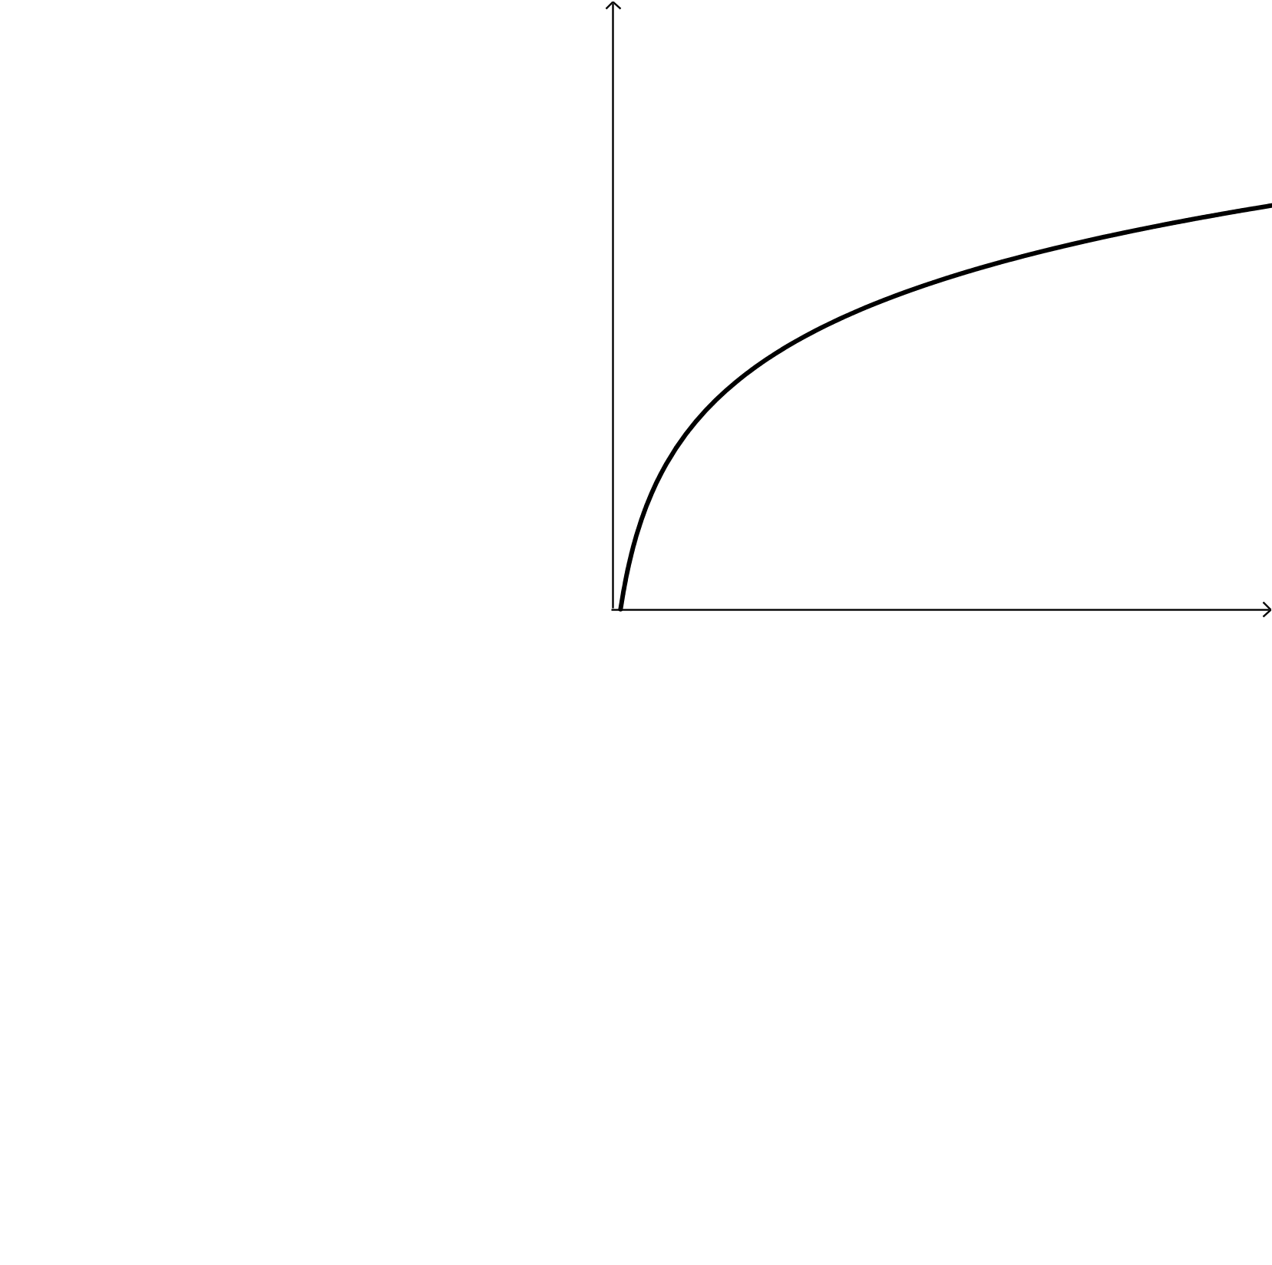
The utility functions
$$u(x)$$
$$u\left(C_{I}^{1}+C_{I}^{2}−1\right)$$
$$C^{1}+C^{2}−1$$

Slide 34
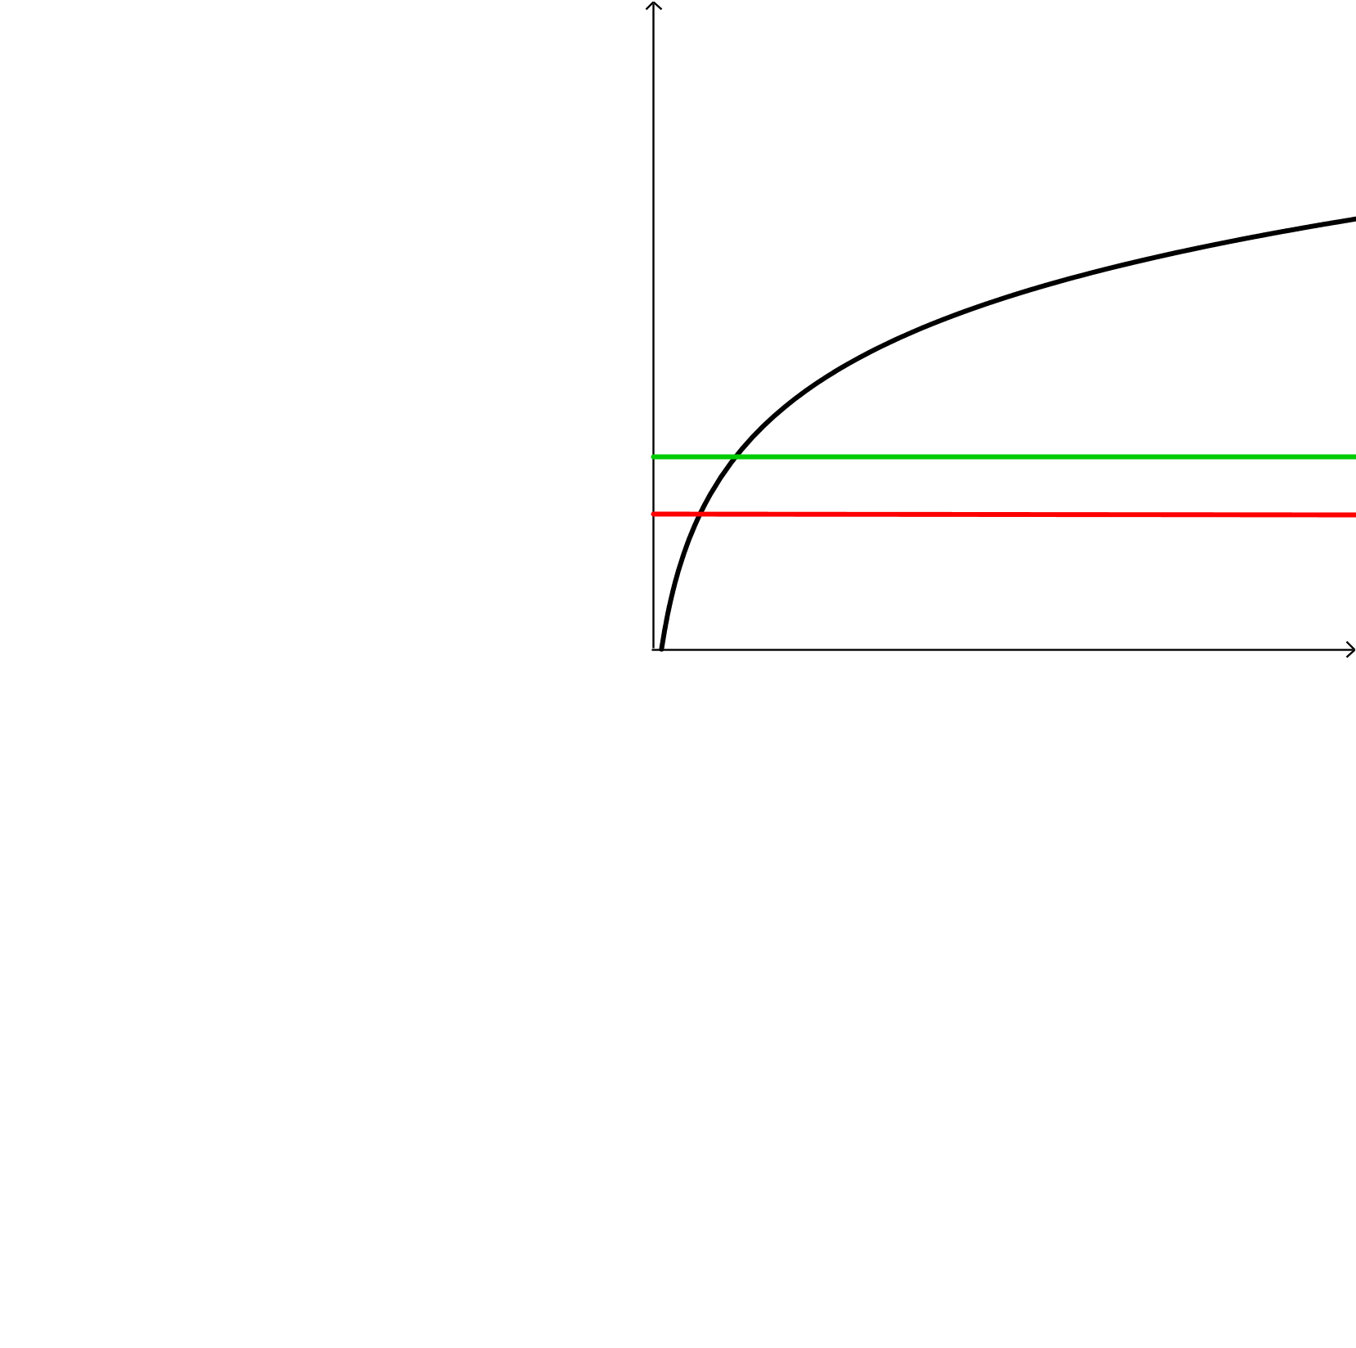
The utility functions
$$u(x)$$
$$u\left(C_{I}^{1}+C_{I}^{2}−1\right)$$
$$\overline{u}$$
$$β\overline{u}$$
$$C^{1}+C^{2}−1$$

Slide 35
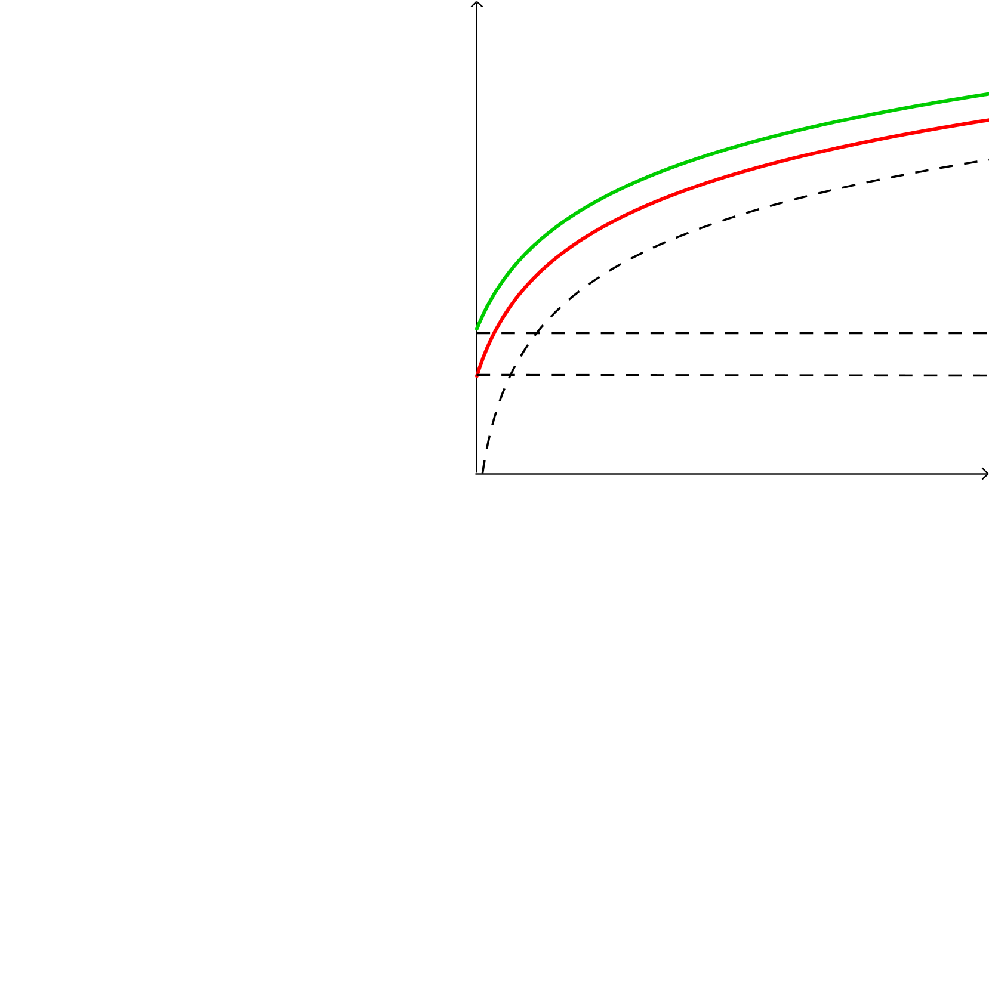
The utility functions
$$u(x)$$
$$\overline{u}+u\left(C^{1}+C^{2}−1\right)$$
$$β\overline{u}+u\left(C_{I}^{1}+C_{I}^{2}−1\right)$$
$$u\left(C_{I}^{1}+C_{I}^{2}−1\right)$$
$$\overline{u}$$
$$β\overline{u}$$
$$C^{1}+C^{2}−1$$

Slide 36
One more assumption
Constant-return-to-scale technologies

Slide 37
One more assumption
Constant-return-to-scale technologies
$i$: illiquid (higher-yield technology)

Slide 38
One more assumption
Constant-return-to-scale technologies
$i$: illiquid (higher-yield technology)
$$T: 0 1 2$$
$i$ : $−1 { R}_{i}$

Slide 39
One more assumption
Constant-return-to-scale technologies
$i$: illiquid (higher-yield technology)
$l$: liquid (lower-yield technology)
$$T: 0 1 2$$
$i$ : $−1 { R}_{i}$

Slide 40
One more assumption
Constant-return-to-scale technologies
$i$: illiquid (higher-yield technology)
$l$: liquid (lower-yield technology)
$$T: 0 1 2$$
$i$ : $−1 { R}_{i}$
$$−1 1$$
$l$ :

Slide 41
One more assumption
Constant-return-to-scale technologies
$i$: illiquid (higher-yield technology)
$l$: liquid (lower-yield technology)
$$T: 0 1 2$$
$i$ : $−1 { R}_{i}$
$$−1 1$$
$l$ :
$$−1 R_{l}$$

Slide 42
One more assumption
Constant-return-to-scale technologies
$i$: illiquid (higher-yield technology)
$l$: liquid (lower-yield technology)
$$T: 0 1 2$$
$i$ : $−1 { R}_{i}$
$$1<R_{l}<{ R}_{i}$$
$$−1 1$$
$l$ :
$$−1 R_{l}$$

Slide 43
Recap (What’s new?)
$α∽f_{α}\left(α\right){∗1 }_{\left[0,\overline{α}\right]}\left(α\right)$
$U\left(x\right)=$
$i$ (illiquid) returns${ R}_{i}$ in $T=2$
$l$ (liquid) returns $R_{l}$ in $T=2$
$$\overline{u}$$
$$or$$
$$+ u\left(C^{1}+C^{2}−1\right)$$
$$β\overline{u}$$

Slide 44
Banks

Slide 45
Banks
Separated system
(only $l$)

Slide 46
Banks
Separated system
Unified system
(only $l$)
(both $l$ and $i$)

Slide 47
Banks
Separated system
Unified system
(only $l$)
(both $l$ and $i$)

Slide 48
Contract
$$specifies \left\{\begin{aligned}γ \\ c^{1}\left(z\right) \\ c_{I}^{2}(α_{1}) \\ c_{P}^{2}\left(α_{1}\right)\end{aligned}\right.$$
$γ=$ $\%$ $of endowment in l$
$c^{1}\left(z\right)=$ $withdrawal in T=1$
$$c_{I}^{2}\left(α_{1}\right)=withdrawal in T=2 for who also withdrew in T=1$$
$$c_{P}^{2}\left(α_{1}\right)=withdrawal in T=2 for who did not withdraw$$
$in T=1$

Slide 49
Contract
$$specifies \left\{\begin{aligned}γ \\ c^{1}\left(z\right) \\ c_{I}^{2}(α_{1}) \\ c_{P}^{2}\left(α_{1}\right)\end{aligned}\right.$$
$γ=$ $\%$ $of endowment in l$
$c^{1}\left(z\right)=$ $withdrawal in T=1$
$$c_{I}^{2}\left(α_{1}\right)=withdrawal in T=2 for who also withdrew in T=1$$
$$c_{P}^{2}\left(α_{1}\right)=withdrawal in T=2 for who did not withdraw$$
$in T=1$

Slide 50
Contract
$$specifies \left\{\begin{aligned}γ \\ c^{1}\left(z\right) \\ c_{I}^{2}(α_{1}) \\ c_{P}^{2}\left(α_{1}\right)\end{aligned}\right.$$
$γ=$ $\%$ $of endowment in l$
$c^{1}\left(z\right)=$ $withdrawal in T=1$
$$c_{I}^{2}\left(α_{1}\right)=withdrawal in T=2 if he also withdrew in T=1$$
$$c_{P}^{2}\left(α_{1}\right)=withdrawal in T=2 for who did not withdraw$$
$in T=1$

Slide 51
Contract
$$specifies \left\{\begin{aligned}γ \\ c^{1}\left(z\right) \\ c_{I}^{2}(α_{1}) \\ c_{P}^{2}\left(α_{1}\right)\end{aligned}\right.$$
$γ=$ $\%$ $of endowment in l$
$c^{1}\left(z\right)=$ $withdrawal in T=1$
$$c_{I}^{2}\left(α_{1}\right)=withdrawal in T=2 if he also withdrew in T=1$$
$$c_{P}^{2}\left(α_{1}\right)=withdrawal in T=2 if he did not withdraw$$
$in T=1$

Slide 52
Welfare
No entry costs

Slide 53
Welfare
No entry costs
Perfect competition

Slide 54
Welfare
No entry costs
Perfect competition
Maximize utility

Slide 55
Welfare
Remarks:
$c^{1}\left(z\right)=$ $1$
Maximum withdrawal in $T=1$

Slide 56
Welfare
Remarks:
$c^{1}\left(z\right)=$ $1$
$γy≤ \overline{α}∗1$
Maximum withdrawal in $T=1$
Maximum investment in $l$

Slide 57
Welfare
$$α$$
$α≤γy$
All impatient agents satisfied

Slide 58
Welfare
$$α$$
$α≤γy$
$α>γy$
All impatient agents satisfied
Only $γy$impatient agents satisfied

Slide 59
Welfare
$$W= \int_{0}^{γy}{\left[\overline{u}+\left(1−α\right)u\left(\left(1−γ\right)yR_{i}+c_{P}^{2}\left(α\right)−1\right)+αu\left(\left(1−γ\right)yR_{i}+c_{I}^{2}\left(α\right)\right)\right]f\left(α\right)dα+}$$
$$+\int_{γy}^{\overline{α}}{[\left(1−α+γy\right)\overline{u}+\left(α−γy\right)β\overline{u}+\left(1−α\right)u\left(\left(1−γ\right)yR_{i}+c_{P}^{2}\left(α\right)−1\right)+}$$
$$+\left(α−γy\right)u\left(\left(1−γ\right)yR_{i}+c_{P}^{2}\left(α\right)−1\right)+γyu\left(\left(1−γ\right)yR_{i}+c_{I}^{2}\left(α\right)\right)]f\left(α\right)dα$$

Slide 60
Welfare
$$W= \int_{0}^{γy}{\left[\overline{u}+\left(1−α\right)u\left(\left(1−γ\right)yR_{i}+c_{P}^{2}\left(α\right)−1\right)+αu\left(\left(1−γ\right)yR_{i}+c_{I}^{2}\left(α\right)\right)\right]f\left(α\right)dα+}$$
$$+\int_{γy}^{\overline{α}}{[\left(1−α+γy\right)\overline{u}+\left(α−γy\right)β\overline{u}+\left(1−α\right)u\left(\left(1−γ\right)yR_{i}+c_{P}^{2}\left(α\right)−1\right)+}$$
$$+\left(α−γy\right)u\left(\left(1−γ\right)yR_{i}+c_{P}^{2}\left(α\right)−1\right)+γyu\left(\left(1−γ\right)yR_{i}+c_{I}^{2}\left(α\right)\right)]f\left(α\right)dα$$

Slide 61
Welfare
$$W= \int_{0}^{γy}{\left[\overline{u}+\left(1−α\right)u\left(\left(1−γ\right)yR_{i}+c_{P}^{2}\left(α\right)−1\right)+αu\left(\left(1−γ\right)yR_{i}+c_{I}^{2}\left(α\right)\right)\right]f\left(α\right)dα+}$$
$$+\int_{γy}^{\overline{α}}{[\left(1−α+γy\right)\overline{u}+\left(α−γy\right)β\overline{u}+\left(1−α\right)u\left(\left(1−γ\right)yR_{i}+c_{P}^{2}\left(α\right)−1\right)+}$$
$$+\left(α−γy\right)u\left(\left(1−γ\right)yR_{i}+c_{P}^{2}\left(α\right)−1\right)+γyu\left(\left(1−γ\right)yR_{i}+c_{I}^{2}\left(α\right)\right)]f\left(α\right)dα$$

Slide 62
Welfare
Nobody is rationed
$$\int_{0}^{γy}{\left\{α\left[\overline{u}+u\left(C_{I}^{T}\right)\right]+\left(1−α\right)\left[\overline{u}+u\left(C_{P}^{T}\right)\right]\right\}f\left(α\right)dα}$$
$α\left[\overline{u}+u\left(C_{I}^{T}\right)\right]$ : utility of all impatient agents

Slide 63
Welfare
Nobody is rationed
$$\int_{0}^{γy}{\left\{α\left[\overline{u}+u\left(C_{I}^{T}\right)\right]+\left(1−α\right)\left[\overline{u}+u\left(C_{P}^{T}\right)\right]\right\}f\left(α\right)dα}$$
$α\left[\overline{u}+u\left(C_{I}^{T}\right)\right]$ : utility of all impatient agents
$\left(1−α\right)\left[\overline{u}+u\left(C_{P}^{T}\right)\right]$ : utility of all patient agents

Slide 64
Welfare
$\left(α−γy\right) are$ rationed
$$\int_{γy}^{\overline{α}}{\left\{γy\left[\overline{u}+u\left(C_{I}^{T}\right)\right]+\left(1−α\right)\left[\overline{u}+u\left(C_{P}^{T}\right)\right]+\left(α−γy\right)\left[β\overline{u}+u\left(C_{P}^{T}\right)\right]\right\}f\left(α\right)dα}$$
$γy\left[\overline{u}+u\left(C_{I}^{T}\right)\right]$ : utility of all satisfied impatient agents

Slide 65
Welfare
$\left(α−γy\right) are$ rationed
$$\int_{γy}^{\overline{α}}{\left\{γy\left[\overline{u}+u\left(C_{I}^{T}\right)\right]+\left(1−α\right)\left[\overline{u}+u\left(C_{P}^{T}\right)\right]+\left(α−γy\right)\left[β\overline{u}+u\left(C_{P}^{T}\right)\right]\right\}f\left(α\right)dα}$$
$γy\left[\overline{u}+u\left(C_{I}^{T}\right)\right]$ : utility of all satisfied impatient agents
$\left(1−α\right)\left[\overline{u}+u\left(C_{P}^{T}\right)\right]$ : utility of all patient agents

Slide 66
Welfare
$\left(α−γy\right) are$ rationed
$$\int_{γy}^{\overline{α}}{\left\{γy\left[\overline{u}+u\left(C_{I}^{T}\right)\right]+\left(1−α\right)\left[\overline{u}+u\left(C_{P}^{T}\right)\right]+\left(α−γy\right)\left[β\overline{u}+u\left(C_{P}^{T}\right)\right]\right\}f\left(α\right)dα}$$
$γy\left[\overline{u}+u\left(C_{I}^{T}\right)\right]$ : utility of all satisfied impatient agents
$\left(1−α\right)\left[\overline{u}+u\left(C_{P}^{T}\right)\right]$ : utility of all patient agents
$\left(α−γy\right)\left[β\overline{u}+u\left(C_{P}^{T}\right)\right]$: utility of all rationed impatient
agents

Slide 67
Welfare
$$f\left(α\right)$$
If it was discrete:
$$α_{1}$$
$$α_{2}$$
$$α$$
$$W\left(α_{1}\right)$$
$$W\left(α_{2}\right)$$

Slide 68
Welfare
$$f\left(α\right)$$
If it was discrete:
$W=W\left(α_{1}\right)P\left(α_{1}\right)$+$W\left(α_{2}\right)P\left(α_{2}\right)+…$
$$α_{1}$$
$$α_{2}$$
$$α$$
$$W\left(α_{1}\right)$$
$$W\left(α_{2}\right)$$

Slide 69
Welfare
$$f\left(α\right)$$
If it was discrete:
$W=W\left(α_{1}\right)P\left(α_{1}\right)$+$W\left(α_{2}\right)P\left(α_{2}\right)+…$
But it is continuous:
$$W=\int_{0}^{α}{\left\{…\right\}}f\left(α\right)dα$$
$$α_{1}$$
$$α_{2}$$
$$α$$
$$W\left(α_{1}\right)$$
$$W\left(α_{2}\right)$$

Slide 70
Constraints
Resource constraint (only $l$)
$${α_{1}c}_{I}^{2}\left(α_{1}\right)+\left(1−α_{1}\right)c_{P}^{2}\left(α_{1}\right)=\left(γy−α_{1}\right)R_{l}$$
$$α_{1}≤γy$$
$${γyc}_{I}^{2}\left(α_{1}\right)+\left(1−γy\right)c_{P}^{2}\left(α_{1}\right)=0$$
$$α_{1}>γy$$

Slide 71
Constraints
Resource constraint (only $l$)
$${α_{1}c}_{I}^{2}\left(α_{1}\right)+\left(1−α_{1}\right)c_{P}^{2}\left(α_{1}\right)=\left(γy−α_{1}\right)R_{l}$$
$$α_{1}≤γy$$
$${γyc}_{I}^{2}\left(α_{1}\right)+\left(1−γy\right)c_{P}^{2}\left(α_{1}\right)=0$$
$$α_{1}>γy$$

Slide 72
Constraints
Resource constraint (only $l$)
$${α_{1}c}_{I}^{2}\left(α_{1}\right)+\left(1−α_{1}\right)c_{P}^{2}\left(α_{1}\right)=\left(γy−α_{1}\right)R_{l}$$
$$α_{1}≤γy$$
$${γyc}_{I}^{2}\left(α_{1}\right)+\left(1−γy\right)c_{P}^{2}\left(α_{1}\right)=0$$
$$α_{1}>γy$$

Slide 73
Constraints
Resource constraint (only $l$)
$${α_{1}c}_{I}^{2}\left(α_{1}\right)+\left(1−α_{1}\right)c_{P}^{2}\left(α_{1}\right)=\left(γy−α_{1}\right)R_{l}$$
$$α_{1}≤γy$$
$${γyc}_{I}^{2}\left(α_{1}\right)+\left(1−γy\right)c_{P}^{2}\left(α_{1}\right)=0$$
$$α_{1}>γy$$
LHS: amount of withdrawals in $T=2$

Slide 74
Constraints
Resource constraint (only $l$)
$${α_{1}c}_{I}^{2}\left(α_{1}\right)+\left(1−α_{1}\right)c_{P}^{2}\left(α_{1}\right)=\left(γy−α_{1}\right)R_{l}$$
$$α_{1}≤γy$$
$${γyc}_{I}^{2}\left(α_{1}\right)+\left(1−γy\right)c_{P}^{2}\left(α_{1}\right)=0$$
$$α_{1}>γy$$
LHS: amount of withdrawals in $T=2$
RHS: resources that can be withdrawn in $T=2$

Slide 75
Constraints
Resource constraint (only $l$)
$${α_{1}c}_{I}^{2}\left(α_{1}\right)+\left(1−α_{1}\right)c_{P}^{2}\left(α_{1}\right)=\left(γy−α_{1}\right)R_{l}$$
$$α_{1}≤γy$$
$${γyc}_{I}^{2}\left(α_{1}\right)+\left(1−γy\right)c_{P}^{2}\left(α_{1}\right)=0$$
$$α_{1}>γy$$
${α_{1}c}_{I}^{2}\left(α_{1}\right)$: withdrawals of impatient agents in $T=2$

Slide 76
Constraints
Resource constraint (only $l$)
$${α_{1}c}_{I}^{2}\left(α_{1}\right)+\left(1−α_{1}\right)c_{P}^{2}\left(α_{1}\right)=\left(γy−α_{1}\right)R_{l}$$
$$α_{1}≤γy$$
$${γyc}_{I}^{2}\left(α_{1}\right)+\left(1−γy\right)c_{P}^{2}\left(α_{1}\right)=0$$
$$α_{1}>γy$$
${α_{1}c}_{I}^{2}\left(α_{1}\right)$: withdrawals of impatient agents in $T=2$
$\left(1−α_{1}\right)c_{P}^{2}\left(α_{1}\right)$: withdrawals of patient agents in $T=2$

Slide 77
Constraints
Resource constraint (only $l$)
$${α_{1}c}_{I}^{2}\left(α_{1}\right)+\left(1−α_{1}\right)c_{P}^{2}\left(α_{1}\right)=\left(γy−α_{1}\right)R_{l}$$
$$α_{1}≤γy$$
$${γyc}_{I}^{2}\left(α_{1}\right)+\left(1−γy\right)c_{P}^{2}\left(α_{1}\right)=0$$
$$α_{1}>γy$$
${γyc}_{I}^{2}\left(α_{1}\right)$: withdrawals of satisfied impatient agents
in $T=2$

Slide 78
Constraints
Resource constraint (only $l$)
$${α_{1}c}_{I}^{2}\left(α_{1}\right)+\left(1−α_{1}\right)c_{P}^{2}\left(α_{1}\right)=\left(γy−α_{1}\right)R_{l}$$
$$α_{1}≤γy$$
$${γyc}_{I}^{2}\left(α_{1}\right)+\left(1−γy\right)c_{P}^{2}\left(α_{1}\right)=0$$
$$α_{1}>γy$$
${γyc}_{I}^{2}\left(α_{1}\right)$: withdrawals of satisfied impatient agents
in $T=2$
$\left(1−γy\right)c_{P}^{2}\left(α_{1}\right)$: withdrawals i$n T=2$ of who did not
withdrawn in $T=1$

Slide 79
Constraints
Resource constraint (only $l$)
$${α_{1}c}_{I}^{2}\left(α_{1}\right)+\left(1−α_{1}\right)c_{P}^{2}\left(α_{1}\right)=\left(γy−α_{1}\right)R_{l}$$
$$α_{1}≤γy$$
$${γyc}_{I}^{2}\left(α_{1}\right)+\left(1−γy\right)c_{P}^{2}\left(α_{1}\right)=0$$
$$α_{1}>γy$$
$γy$: total $l$invested

Slide 80
Constraints
Resource constraint (only $l$)
$${α_{1}c}_{I}^{2}\left(α_{1}\right)+\left(1−α_{1}\right)c_{P}^{2}\left(α_{1}\right)=\left(γy−α_{1}\right)R_{l}$$
$$α_{1}≤γy$$
$${γyc}_{I}^{2}\left(α_{1}\right)+\left(1−γy\right)c_{P}^{2}\left(α_{1}\right)=0$$
$$α_{1}>γy$$
$γy$: total $l$invested
$α_{1}∙1$: total amount of withdrawals of impatient agents
in $T=1$

Slide 81
Constraints
Resource constraint (only $l$)
$${α_{1}c}_{I}^{2}\left(α_{1}\right)+\left(1−α_{1}\right)c_{P}^{2}\left(α_{1}\right)=\left(γy−α_{1}\right)R_{l}$$
$$α_{1}≤γy$$
$${γyc}_{I}^{2}\left(α_{1}\right)+\left(1−γy\right)c_{P}^{2}\left(α_{1}\right)=0$$
$$α_{1}>γy$$
$γy$: total $l$invested
$α_{1}∙1$: total amount of withdrawals of impatient agents
in $T=1$
$R_{l}$: returns on asset $l$

Slide 82
Constraints
Incentive compatibility constraint
$$\int_{0}^{\overline{α}}{u\left(C_{P}^{2}\right)f_{p}\left(α\right)dα≥\int_{0}^{\overline{α}}{u\left(C_{I}^{2}\right)f_{p}\left(α\right)dα}}$$

Slide 83
Constraints
Incentive compatibility constraint
$$\int_{0}^{\overline{α}}{u\left(C_{P}^{2}\right)f_{p}\left(α\right)dα≥\int_{0}^{\overline{α}}{u\left(C_{I}^{2}\right)f_{p}\left(α\right)dα}}$$
$u\left(C_{P}^{2}\right)=$ expected utility of a patient that does not withdraw
in $T=1$

Slide 84
Constraints
Incentive compatibility constraint
$$\int_{0}^{\overline{α}}{u\left(C_{P}^{2}\right)f_{p}\left(α\right)dα≥\int_{0}^{\overline{α}}{u\left(C_{I}^{2}\right)f_{p}\left(α\right)dα}}$$
$u\left(C_{P}^{2}\right)=$ expected utility of a patient that does not withdraw
in $T=1$
$u\left(C_{I}^{2}\right)=$ expected utility of a patient that withdraws in $T=1$

Slide 85
Constraints
Incentive compatibility constraint
$$\int_{0}^{\overline{α}}{u\left(C_{P}^{2}\right)f_{p}\left(α\right)dα≥\int_{0}^{\overline{α}}{u\left(C_{I}^{2}\right)f_{p}\left(α\right)dα}}$$
$u\left(C_{P}^{2}\right)=$ expected utility of a patient that does not withdraw
in $T=1$
$u\left(C_{I}^{2}\right)=$ expected utility of a patient that withdraws in $T=1$
$f_{p}\left(α\right)=$ density of $α$ from a patient consumer’s point of view

Slide 86
Maximization problem
$$max$$
$$W$$
$$γ,{ c}_{I}^{2}\left(α_{1}\right),{ c}_{P}^{2}\left(α_{1}\right)$$
$$s.t.$$
$$\left(ICC\right) and (RC)$$

Slide 87
Results
THEOREM 3.1
A bank will never invest more than $\overline{α}$ in $l$ and there is full
consumption smoothing
i) $c_{I}^{2}\left(α_{1}\right)=c_{P}^{2}\left(α_{1}\right)−1$
ii) Optimal contract $\overset{⇒}{ } γy< \overline{α}$

Slide 88
Results
PROOF
i)
Maximizing W sub. only to the RC, we obtain:
$$c_{I}^{2}\left(α_{1}\right)=c_{P}^{2}\left(α_{1}\right)−1$$
Consumption Smoothing
(i.e. $C_{P}^{TOT}=C_{I}^{TOT}$)

Slide 89
Results
PROOF
i)
Maximizing W sub. only to the RC, we obtain:
$$c_{I}^{2}\left(α_{1}\right)=c_{P}^{2}\left(α_{1}\right)−1$$
Consumption Smoothing
(i.e. $C_{P}^{TOT}=C_{I}^{TOT}$)
Now,
RC
C.S.
ICC

Slide 90
Results
PROOF
ii)
Plugging RC and C.S. conditions in W
$${\left(\frac{∂W}{∂γ}\right)}_{γ=\overline{α}/y}<0$$
Investing more than $\overline{α}$ in $l$ is sub-optimal

Slide 91
Results
THEOREM 3.2
i)
There exists an optimal contract for the unified bank,
also socially optimal

Slide 92
Results
THEOREM 3.2
i)
There exists an optimal contract for the unified bank,
also socially optimal
ii)
Assuming that a patient does not run if indifferent,
$C_{P}^{TOT}=C_{I}^{TOT}\overset{⇒}{ }$ NO RUN

Slide 93
Results
PROOF
i)
Setting the RC and the C.S. to hold is sufficient for
$$max$$
$$W$$
$$\text{to} \text{have} \text{a} \text{solution}$$
$$γ,{ c}_{I}^{2}\left(α_{1}\right),{ c}_{P}^{2}\left(α_{1}\right)$$

Slide 94
Results
PROOF
i)
Setting the RC and the C.S. to hold is sufficient for
$$max$$
$$W$$
$$\text{to} \text{have} \text{a} \text{solution}$$
$$γ,{ c}_{I}^{2}\left(α_{1}\right),{ c}_{P}^{2}\left(α_{1}\right)$$
ii)
Under the optimal contract
$$C_{P}^{TOT}=C_{I}^{TOT}$$
Patient agents are indifferent between running and
not running

Slide 95
Results
PROOF
i)
Setting the RC and the C.S. to hold is sufficient for
$$max$$
$$W$$
$$\text{to} \text{have} \text{a} \text{solution}$$
$$γ,{ c}_{I}^{2}\left(α_{1}\right),{ c}_{P}^{2}\left(α_{1}\right)$$
ii)
Under the optimal contract
$$C_{P}^{TOT}=C_{I}^{TOT}$$
Patient agents are indifferent between running and
not running
No run equilibrium

Slide 96
Take-aways
“The unified system optimally resolves the trade-off between liquidity and economic growth; in doing so it maximizes social welfare”
“Our Analysis in its present state does not prove that imposing Glass-Steagall restrictions would be a mistake, although it does suggest that one should be skeptical about the purported stability benefits. Before using the model to offer policy advise, moral hazard should be included.”

Slide 97
Sources
Peck, J., & Shell, K. (2010). Could making banks hold only liquid assets induce bank runs? Journal of Monetary Economics, 57(4), 420-427. doi:10.1016/j.jmoneco.2010.04.006
Diamond, D. W., & Dybvig, P. H. (1983). Bank Runs, Deposit Insurance, and Liquidity. Journal of Political Economy, 91(3), 401-419. doi:10.1086/261155
Experience News & Events. (n.d.). Retrieved November 12, 2016, from http://www.stern.nyu.edu/experience-stern/news-events/uat_025245
Glass-Steagall Act: http://congressional.proquest.com:80/congressional/docview/t53.d54.00048-stat-0162-100089?accountid=10267

